Slide 1

Scaled Agile
for Practitioners
theITRiskManager.wordpress.com
@PapaChrisMatts

Slide 2
WHY DO AGILE?
Please discuss in Pairs (or threes) for two minutes
(preferably with a stranger).

Slide 3
Analysis
Design
Code
Test
Prod

Slide 5
Analysis
Design
Code
Test
Prod

Slide 6
Analysis
Design
Code
Test
Prod
Kevin Tate

Slide 7
5 mins

Slide 8

http://corporate.dominos.co.uk

Slide 9

Imdb.com

Slide 10
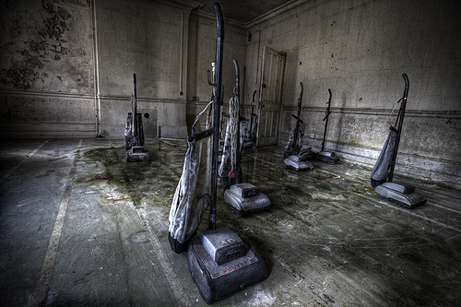

Slide 11
8 mins

Slide 12
Analysis
Design
Code
Test
Prod

Slide 13
10 mins

Slide 14
IT Projects☒

Slide 15
IT Investments☑

Slide 16
Business
Investments
involving IT☑

Slide 17
http://corporate.dominos.co.uk

Slide 18
101
Risk Measure?

Slide 19


Slide 20
10 mins

Slide 21
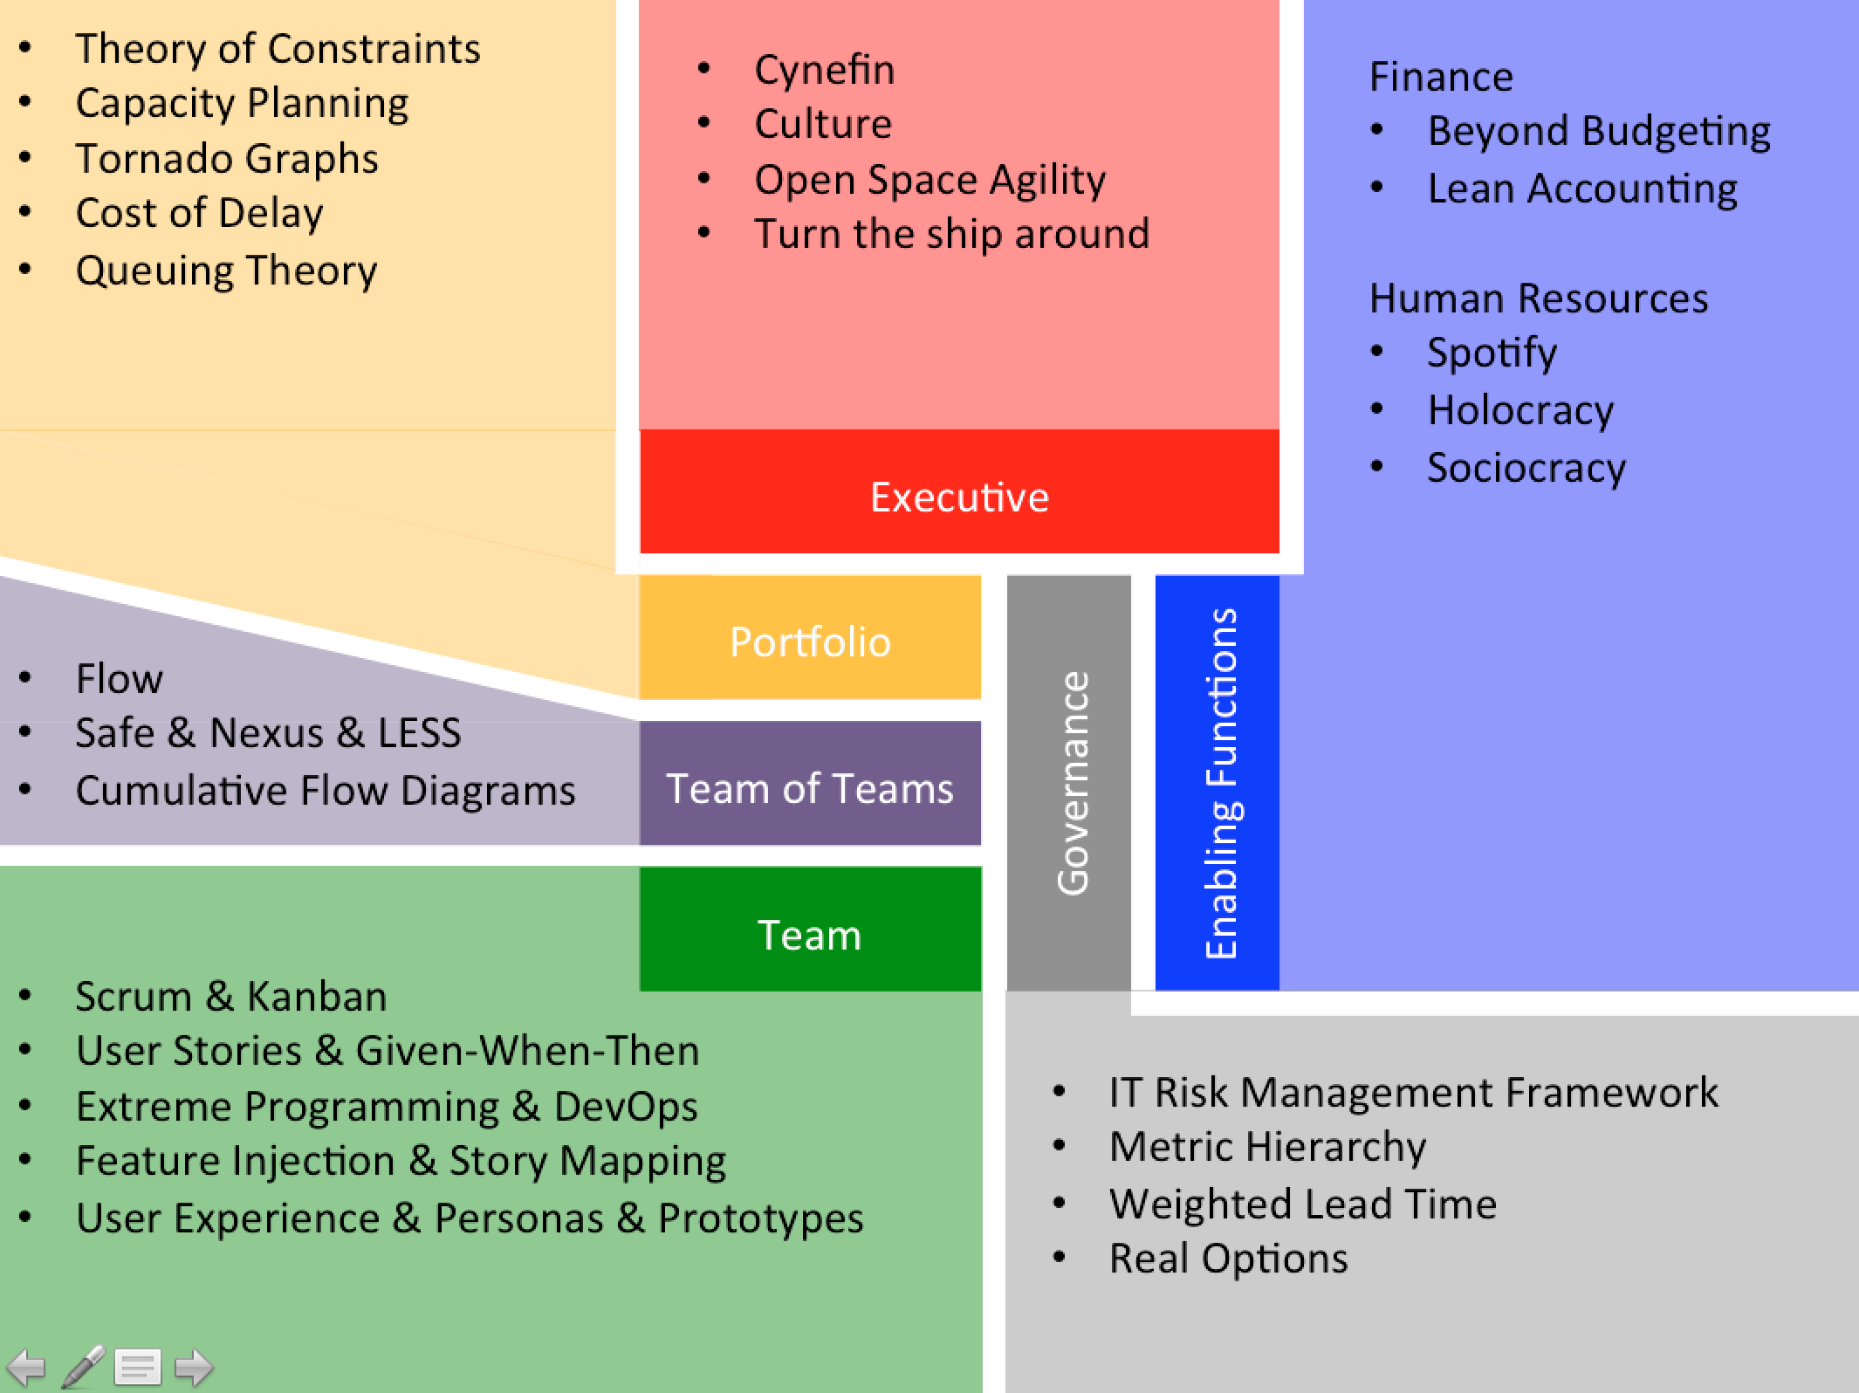
What does Scaled mean?
Please discuss in Pairs (or threes) for two minutes
(preferably with a stranger).

Slide 23
Executive
Portfolio
Stable Delivery Teams
Team of Teams
Governance
Enabling Functions
Team

Slide 24
Executive
Portfolio
Deliver Value
Team of Teams
Governance
Enabling Functions
Team

Slide 25
Executive
Portfolio
Reduce Lead Time
Team of Teams
Governance
Enabling Functions
Team

Slide 26
Executive
Portfolio
Prioritise Portfolio &
Manage Capacity
Team of Teams
Governance
Enabling Functions
Team

Slide 27
Executive
Portfolio
Executive Transparency
Team of Teams
Governance
Enabling Functions
Team
GEMBA
2M
2M
1M

Slide 28
Executive
Portfolio
Agile Governance
Team of Teams
Governance
Enabling Functions
Team
2M
2M
1M

Slide 29
20 mins

Slide 31

Find constraint
Prioritise constraint
Optimise constraint
Add capacity to constraint
Goto 1

Slide 32
Find constraint
Prioritise constraint
Optimise constraint
Add capacity to constraint
Goto 1

Slide 33
Find constraint
Prioritise constraint
Optimise constraint
Add capacity to constraint
Goto 1

Slide 34
✓
✗
✗
✓
✓
✗
Notes:
Organisational Backlog

Slide 35
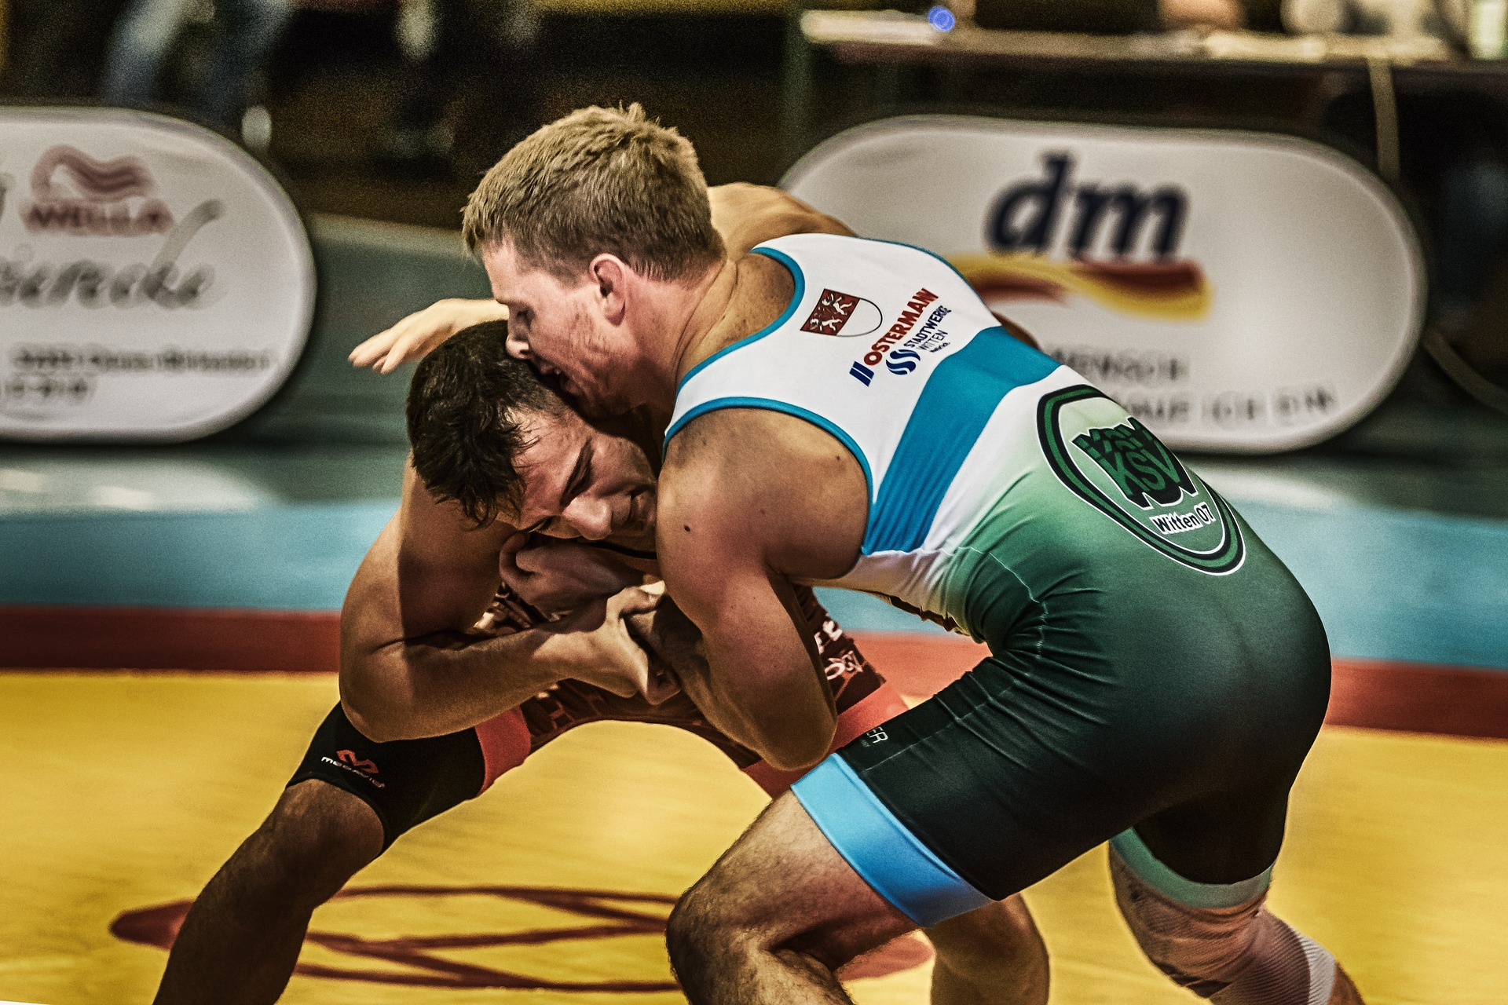
https://pixabay.com/en/wrestle-sport-ring-fight-3793900/
Notes:
Organisational Backlog

Slide 36
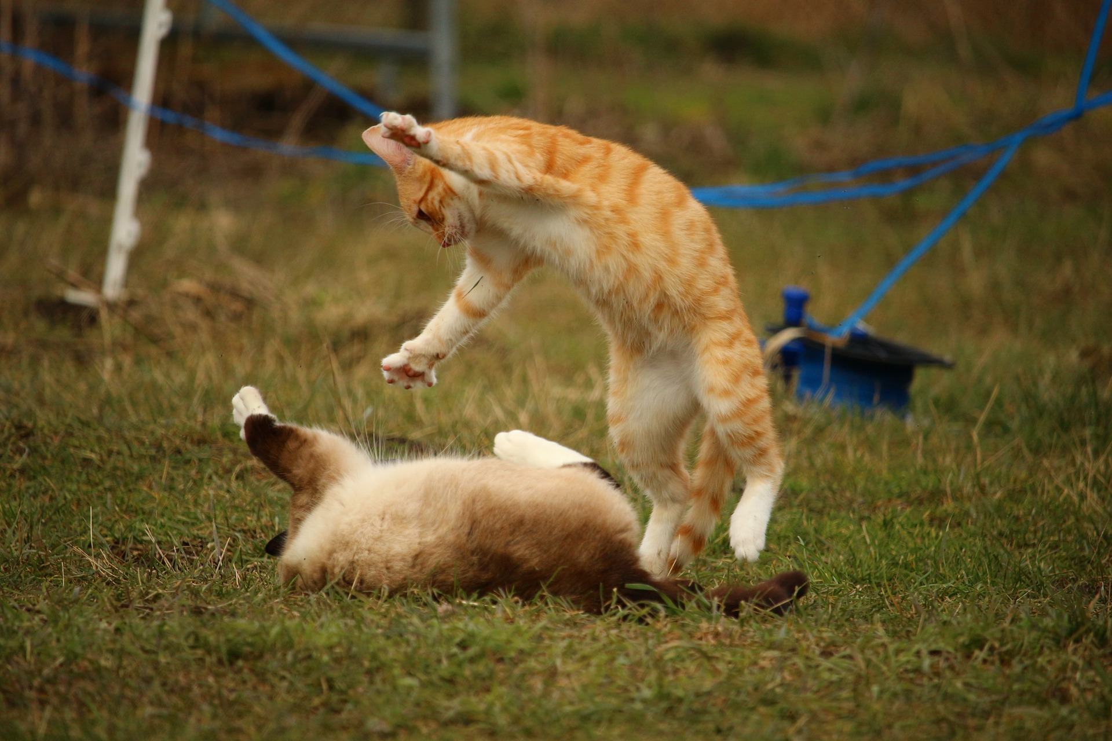
https://pixabay.com/en/cat-siamese-cat-play-red-cat-1234991/
Notes:
Organisational Backlog

Slide 37
IT
IT

Slide 38
IT

Slide 39
0. Build Trust .
Find the constraint
Prioritise constraint
Optimise constraint
Add capacity to constraint
Goto 1

Slide 40
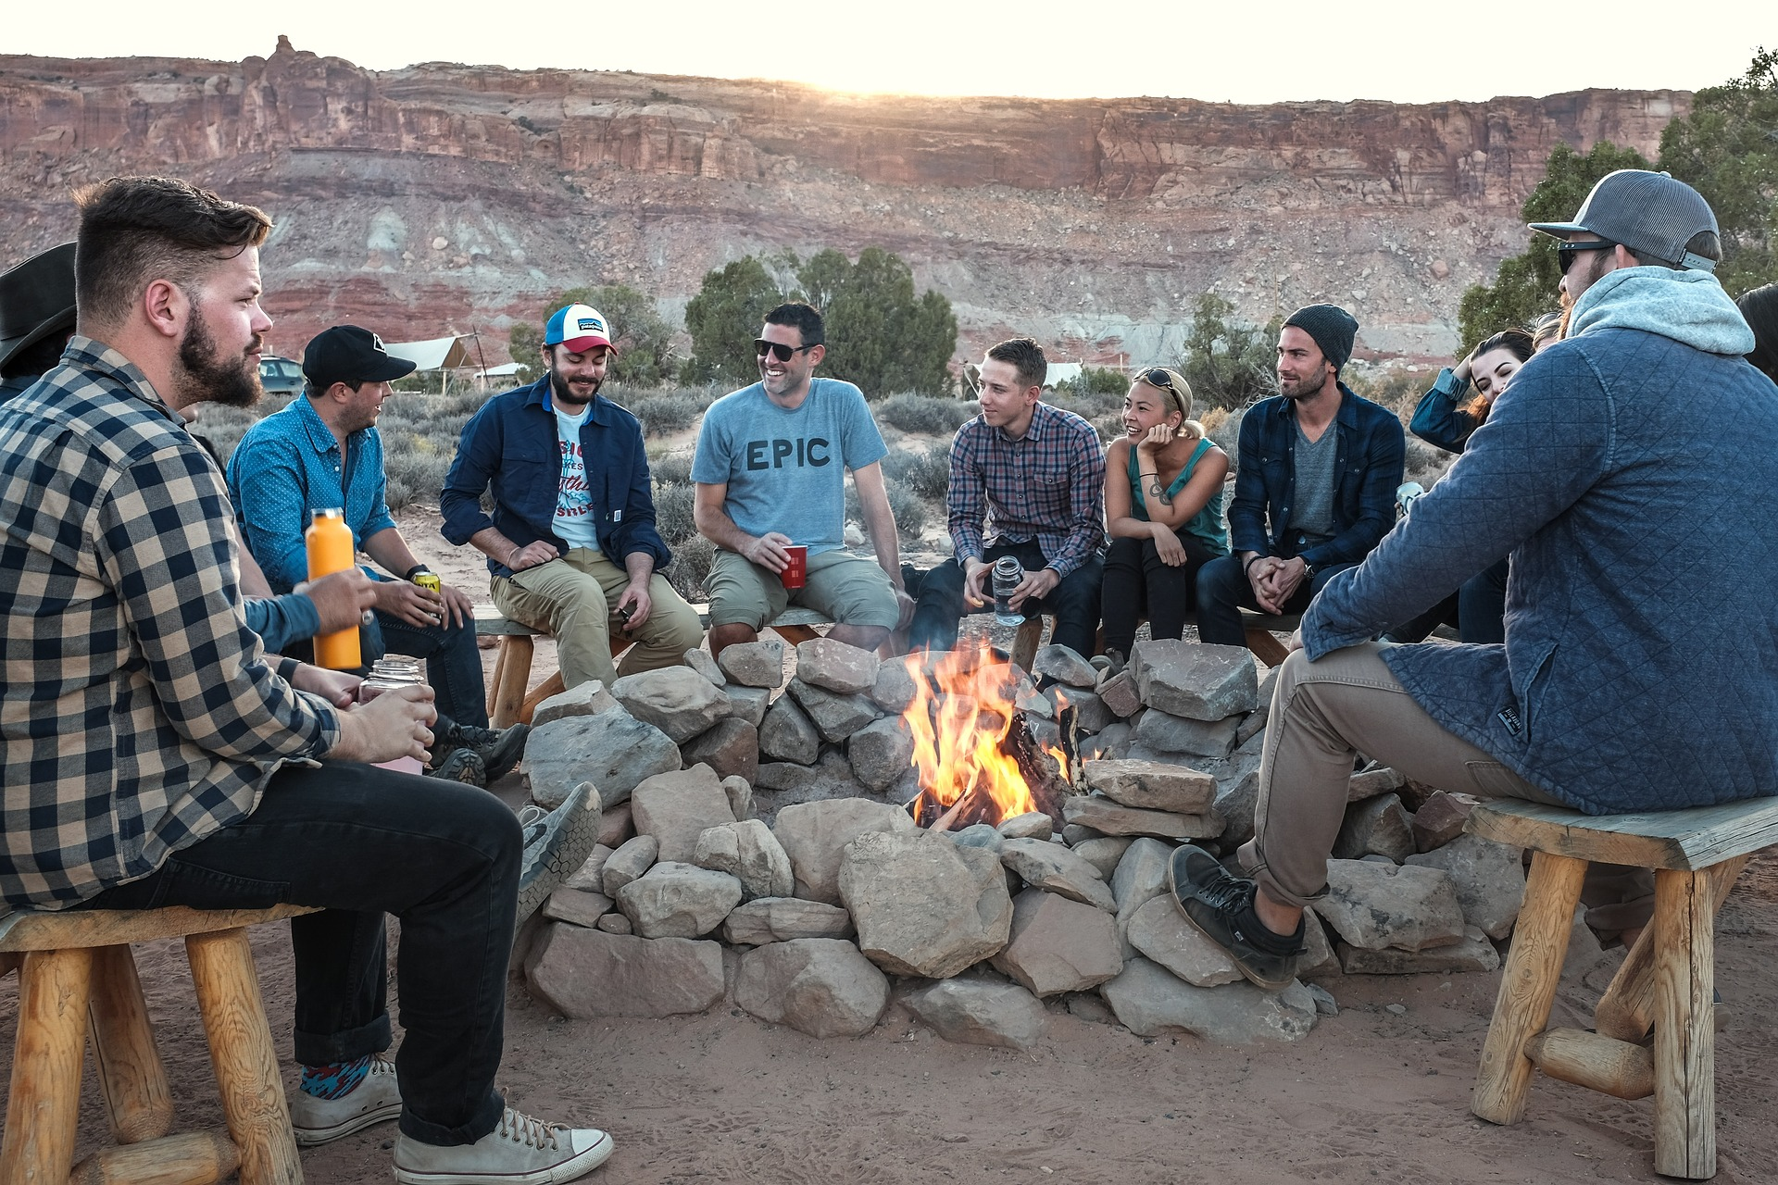
https://pixabay.com/en/people-men-fire-flame-camping-2598902/

Slide 41
Contains
many stories

Slide 42
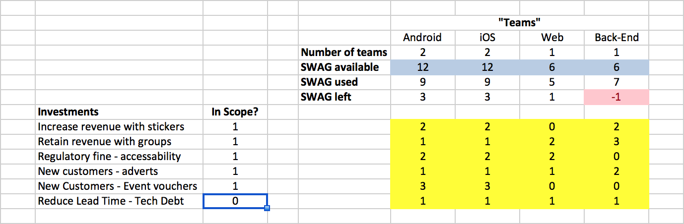
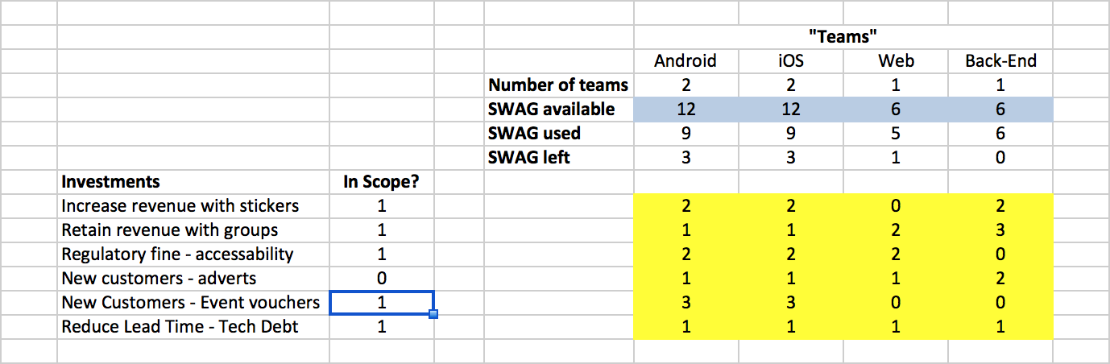

Slide 43
✓
✗
✗
✓
✓
✗
Notes:
Organisational Backlog

Slide 44
Notes:
Team Utilisation

Slide 45
30 mins

Slide 46
✓
HOW PRIORITISE?
✗
✗
✓
✓
✗
Please discuss in Pairs (or threes) for two
minutes (preferably with a stranger).
Notes:
Organisational Backlog

Slide 47
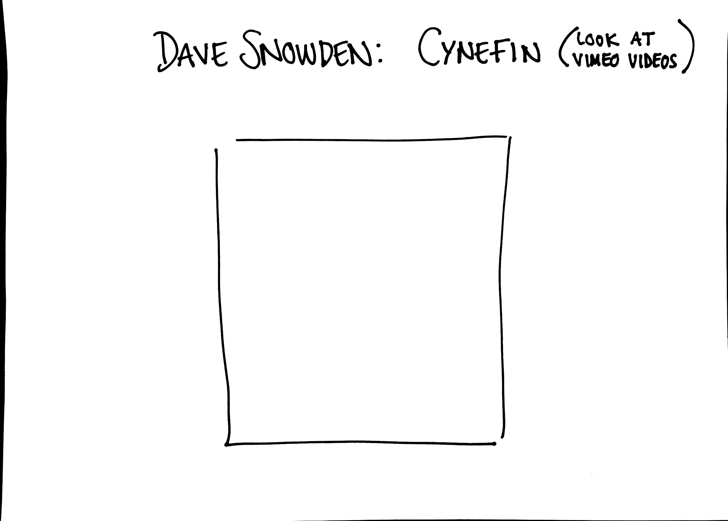

Slide 48
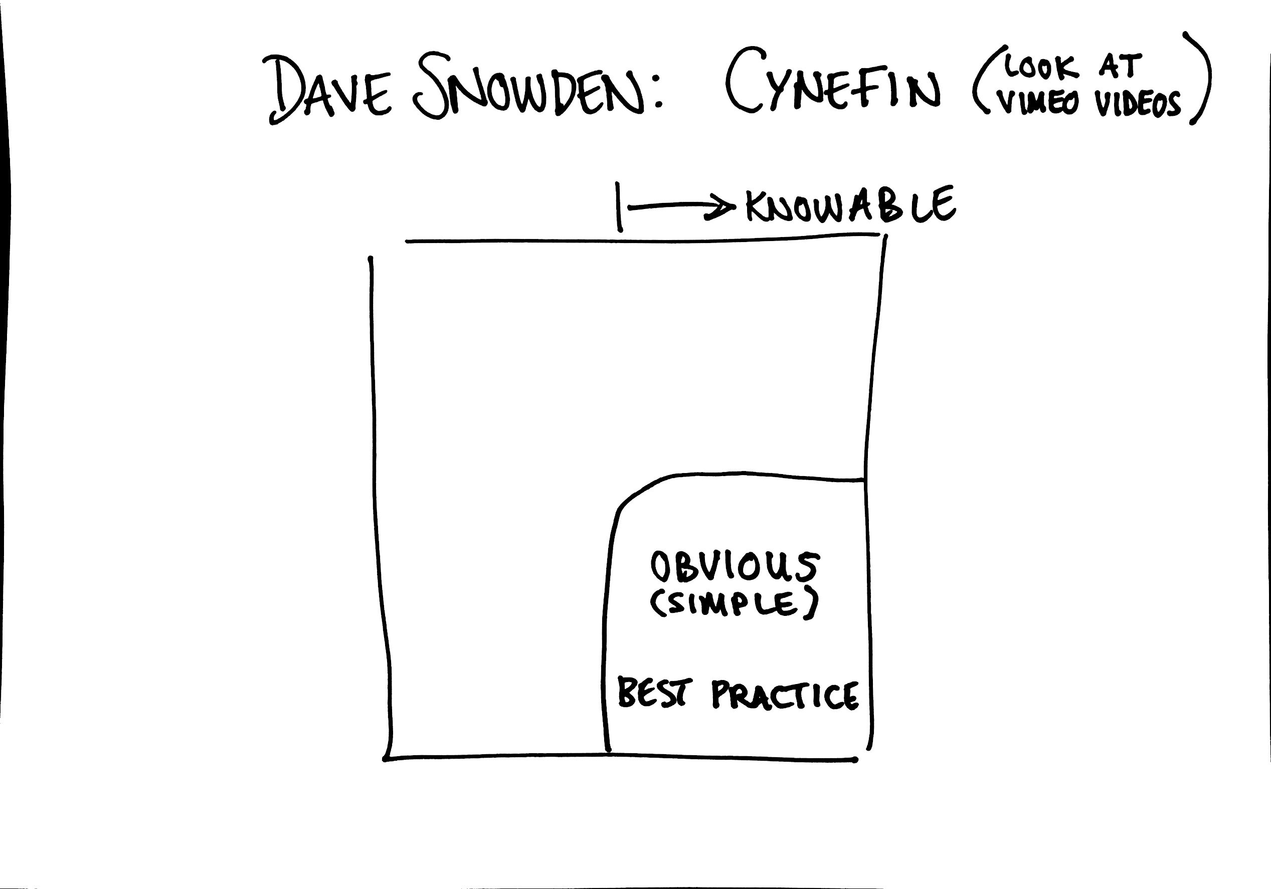

Slide 49
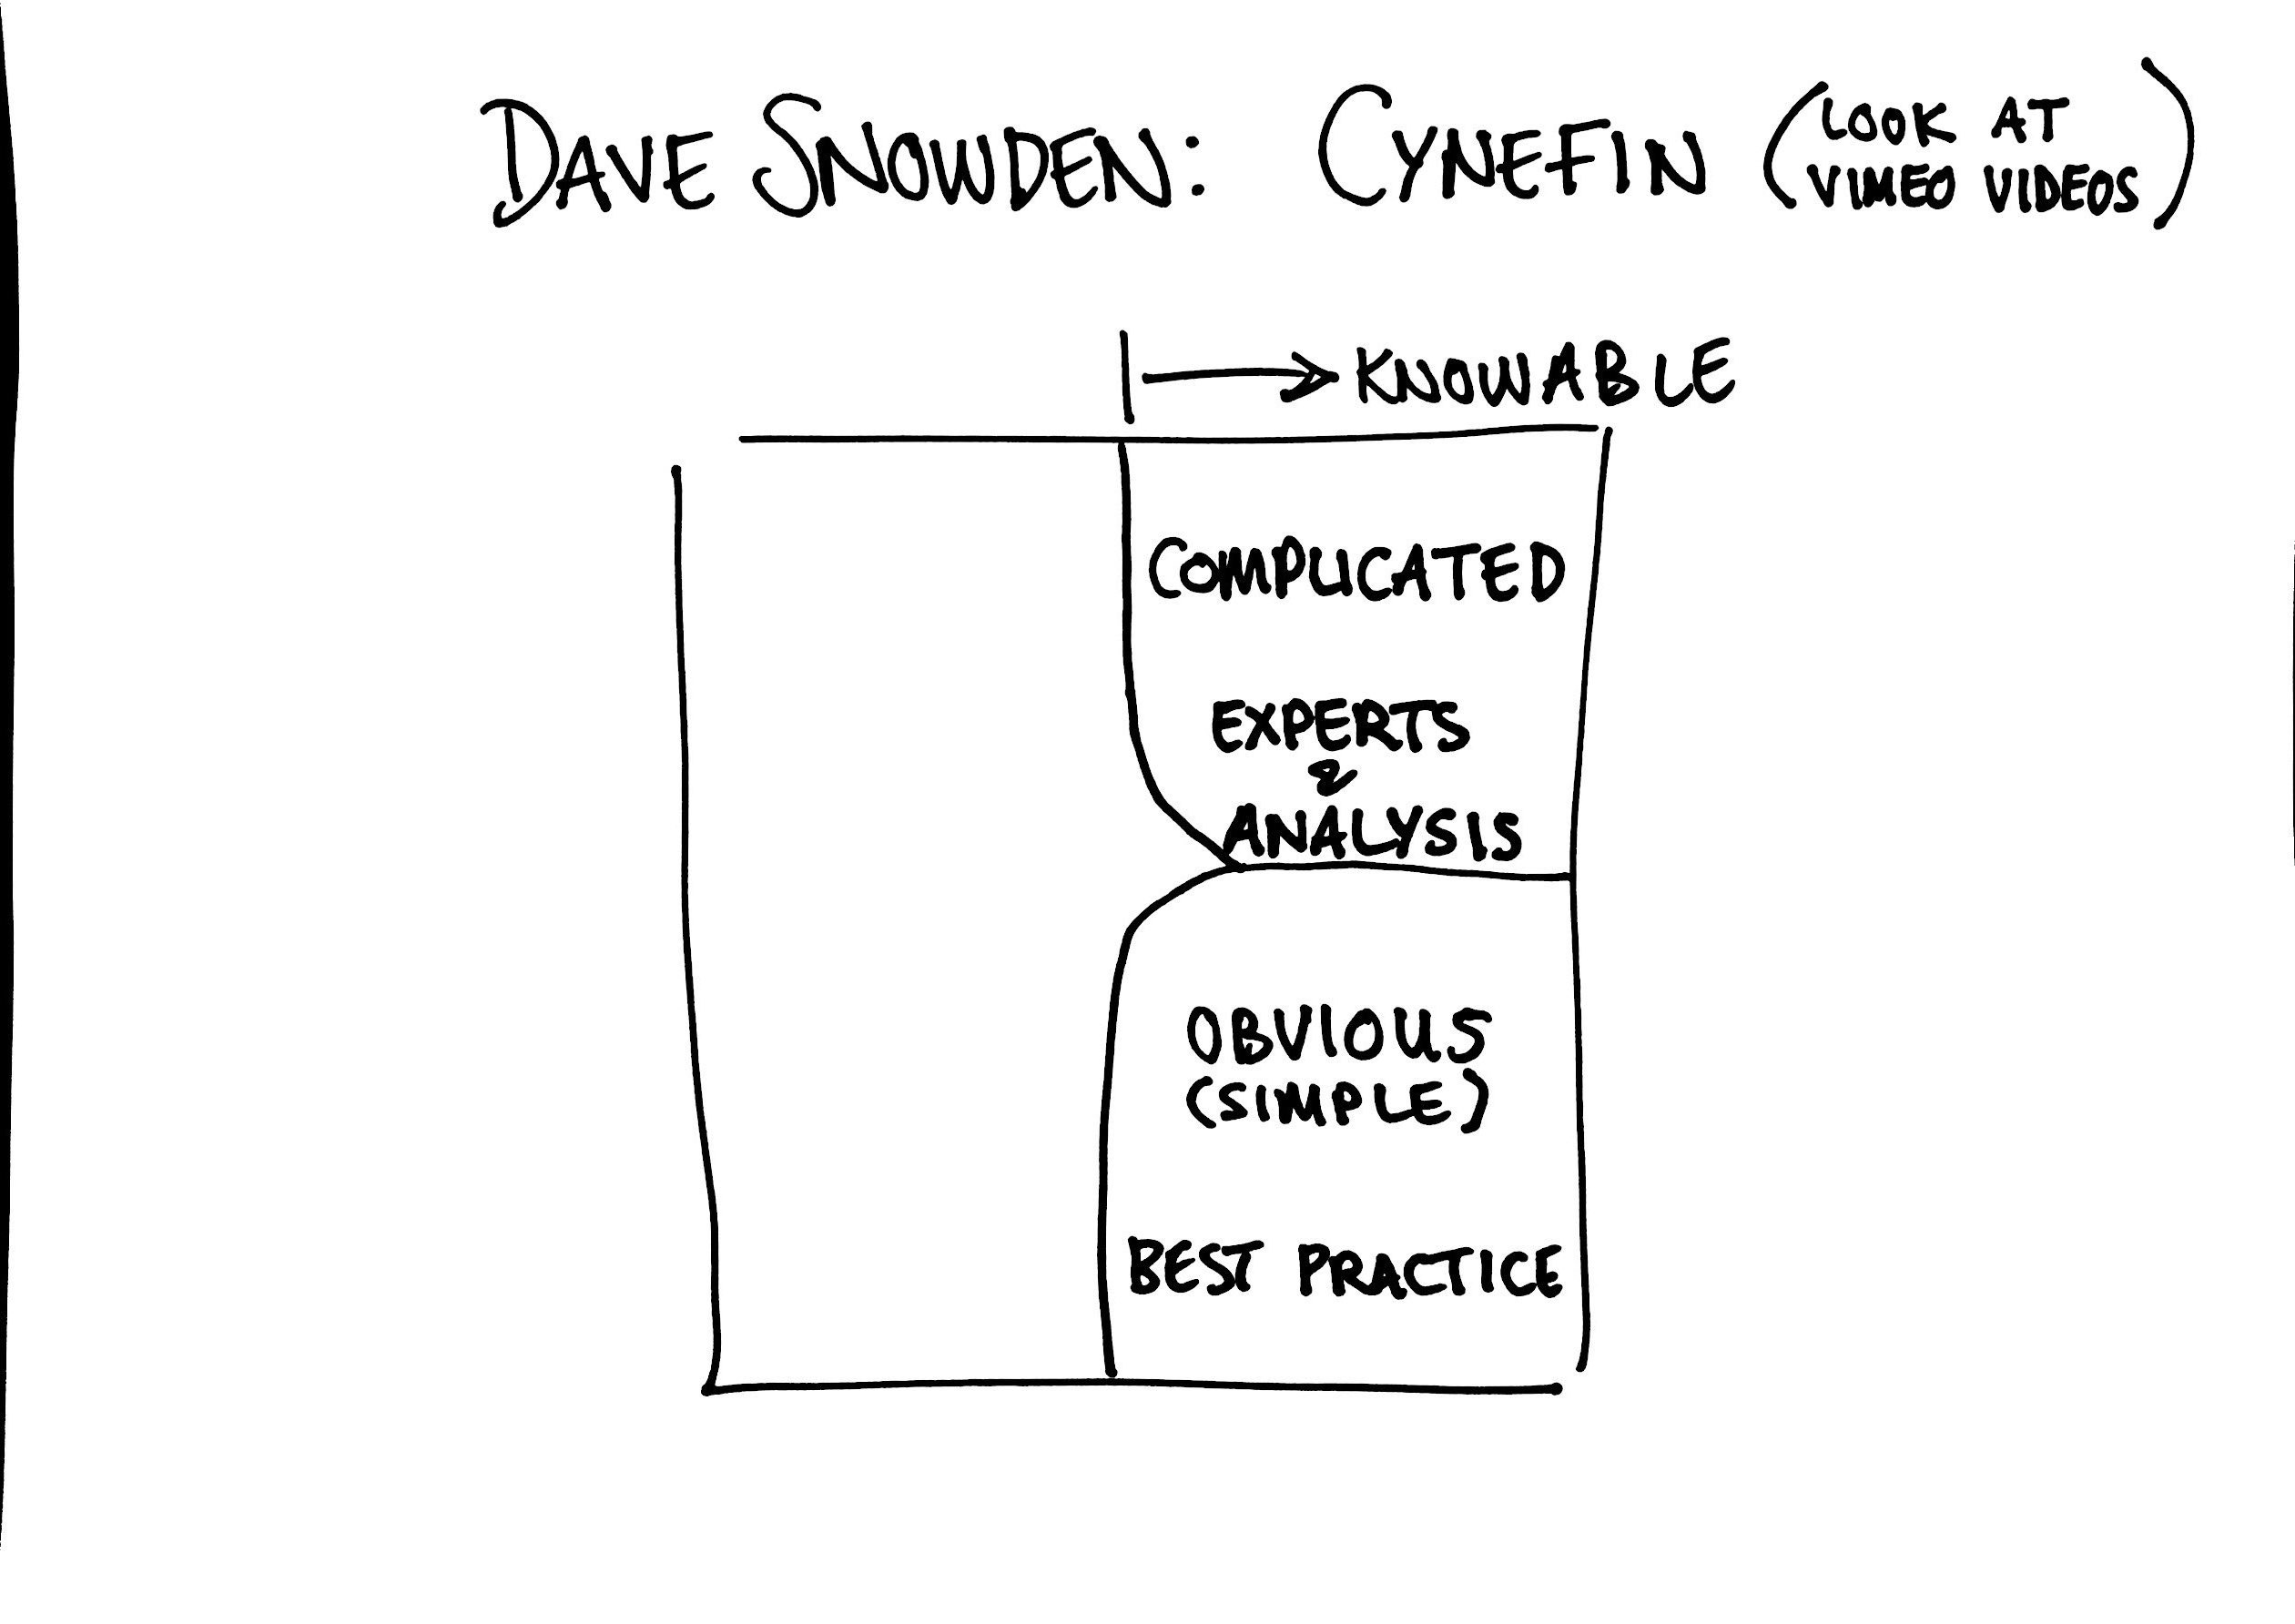

Slide 50
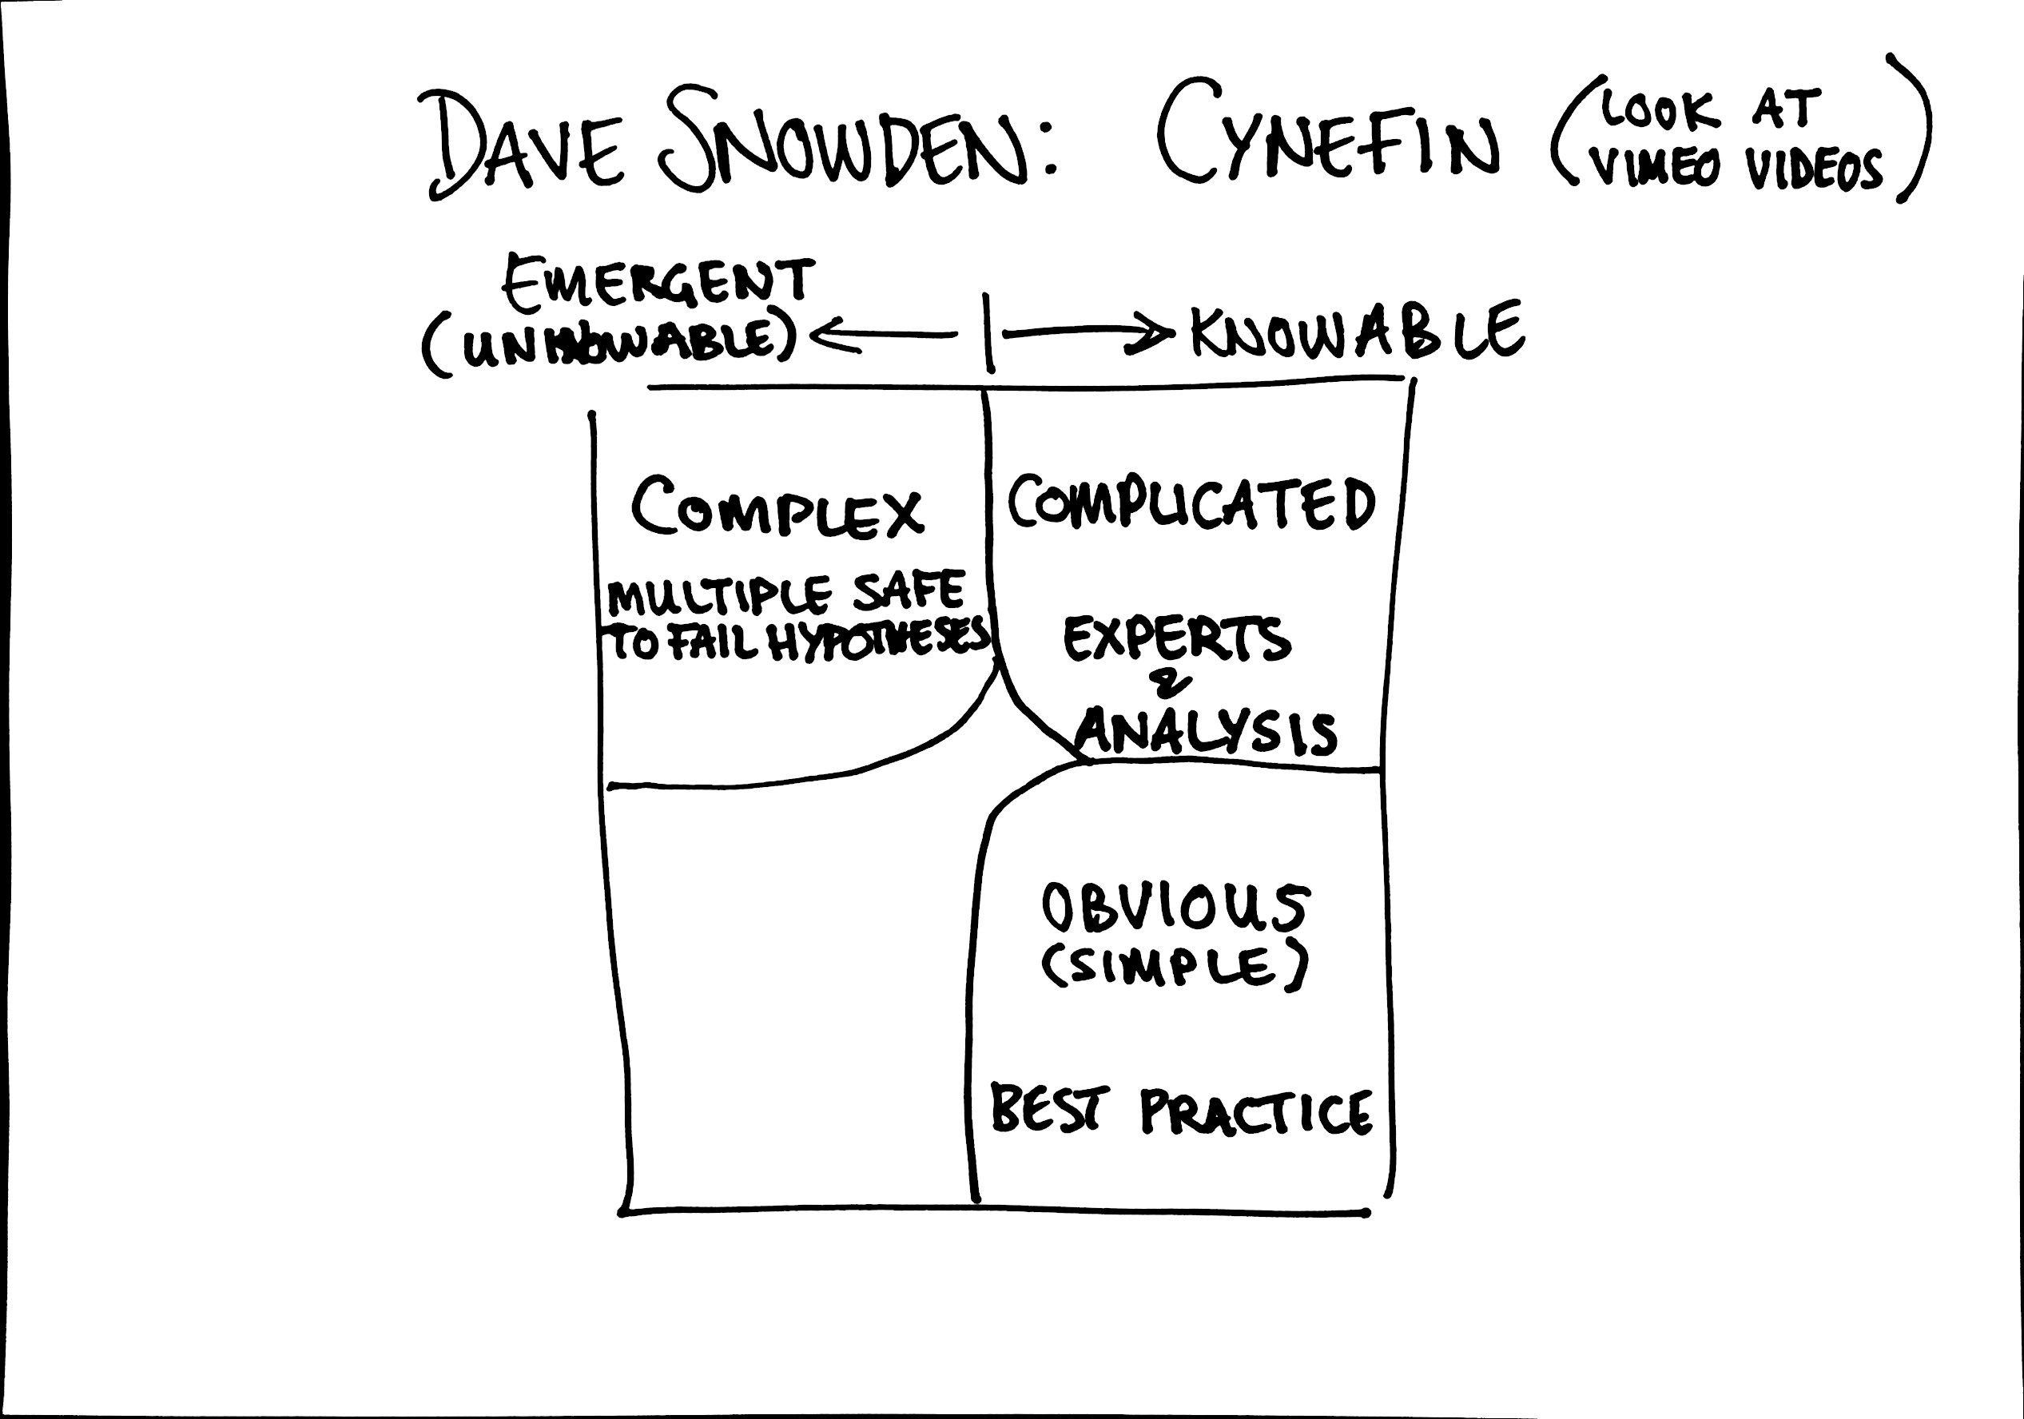

Slide 51
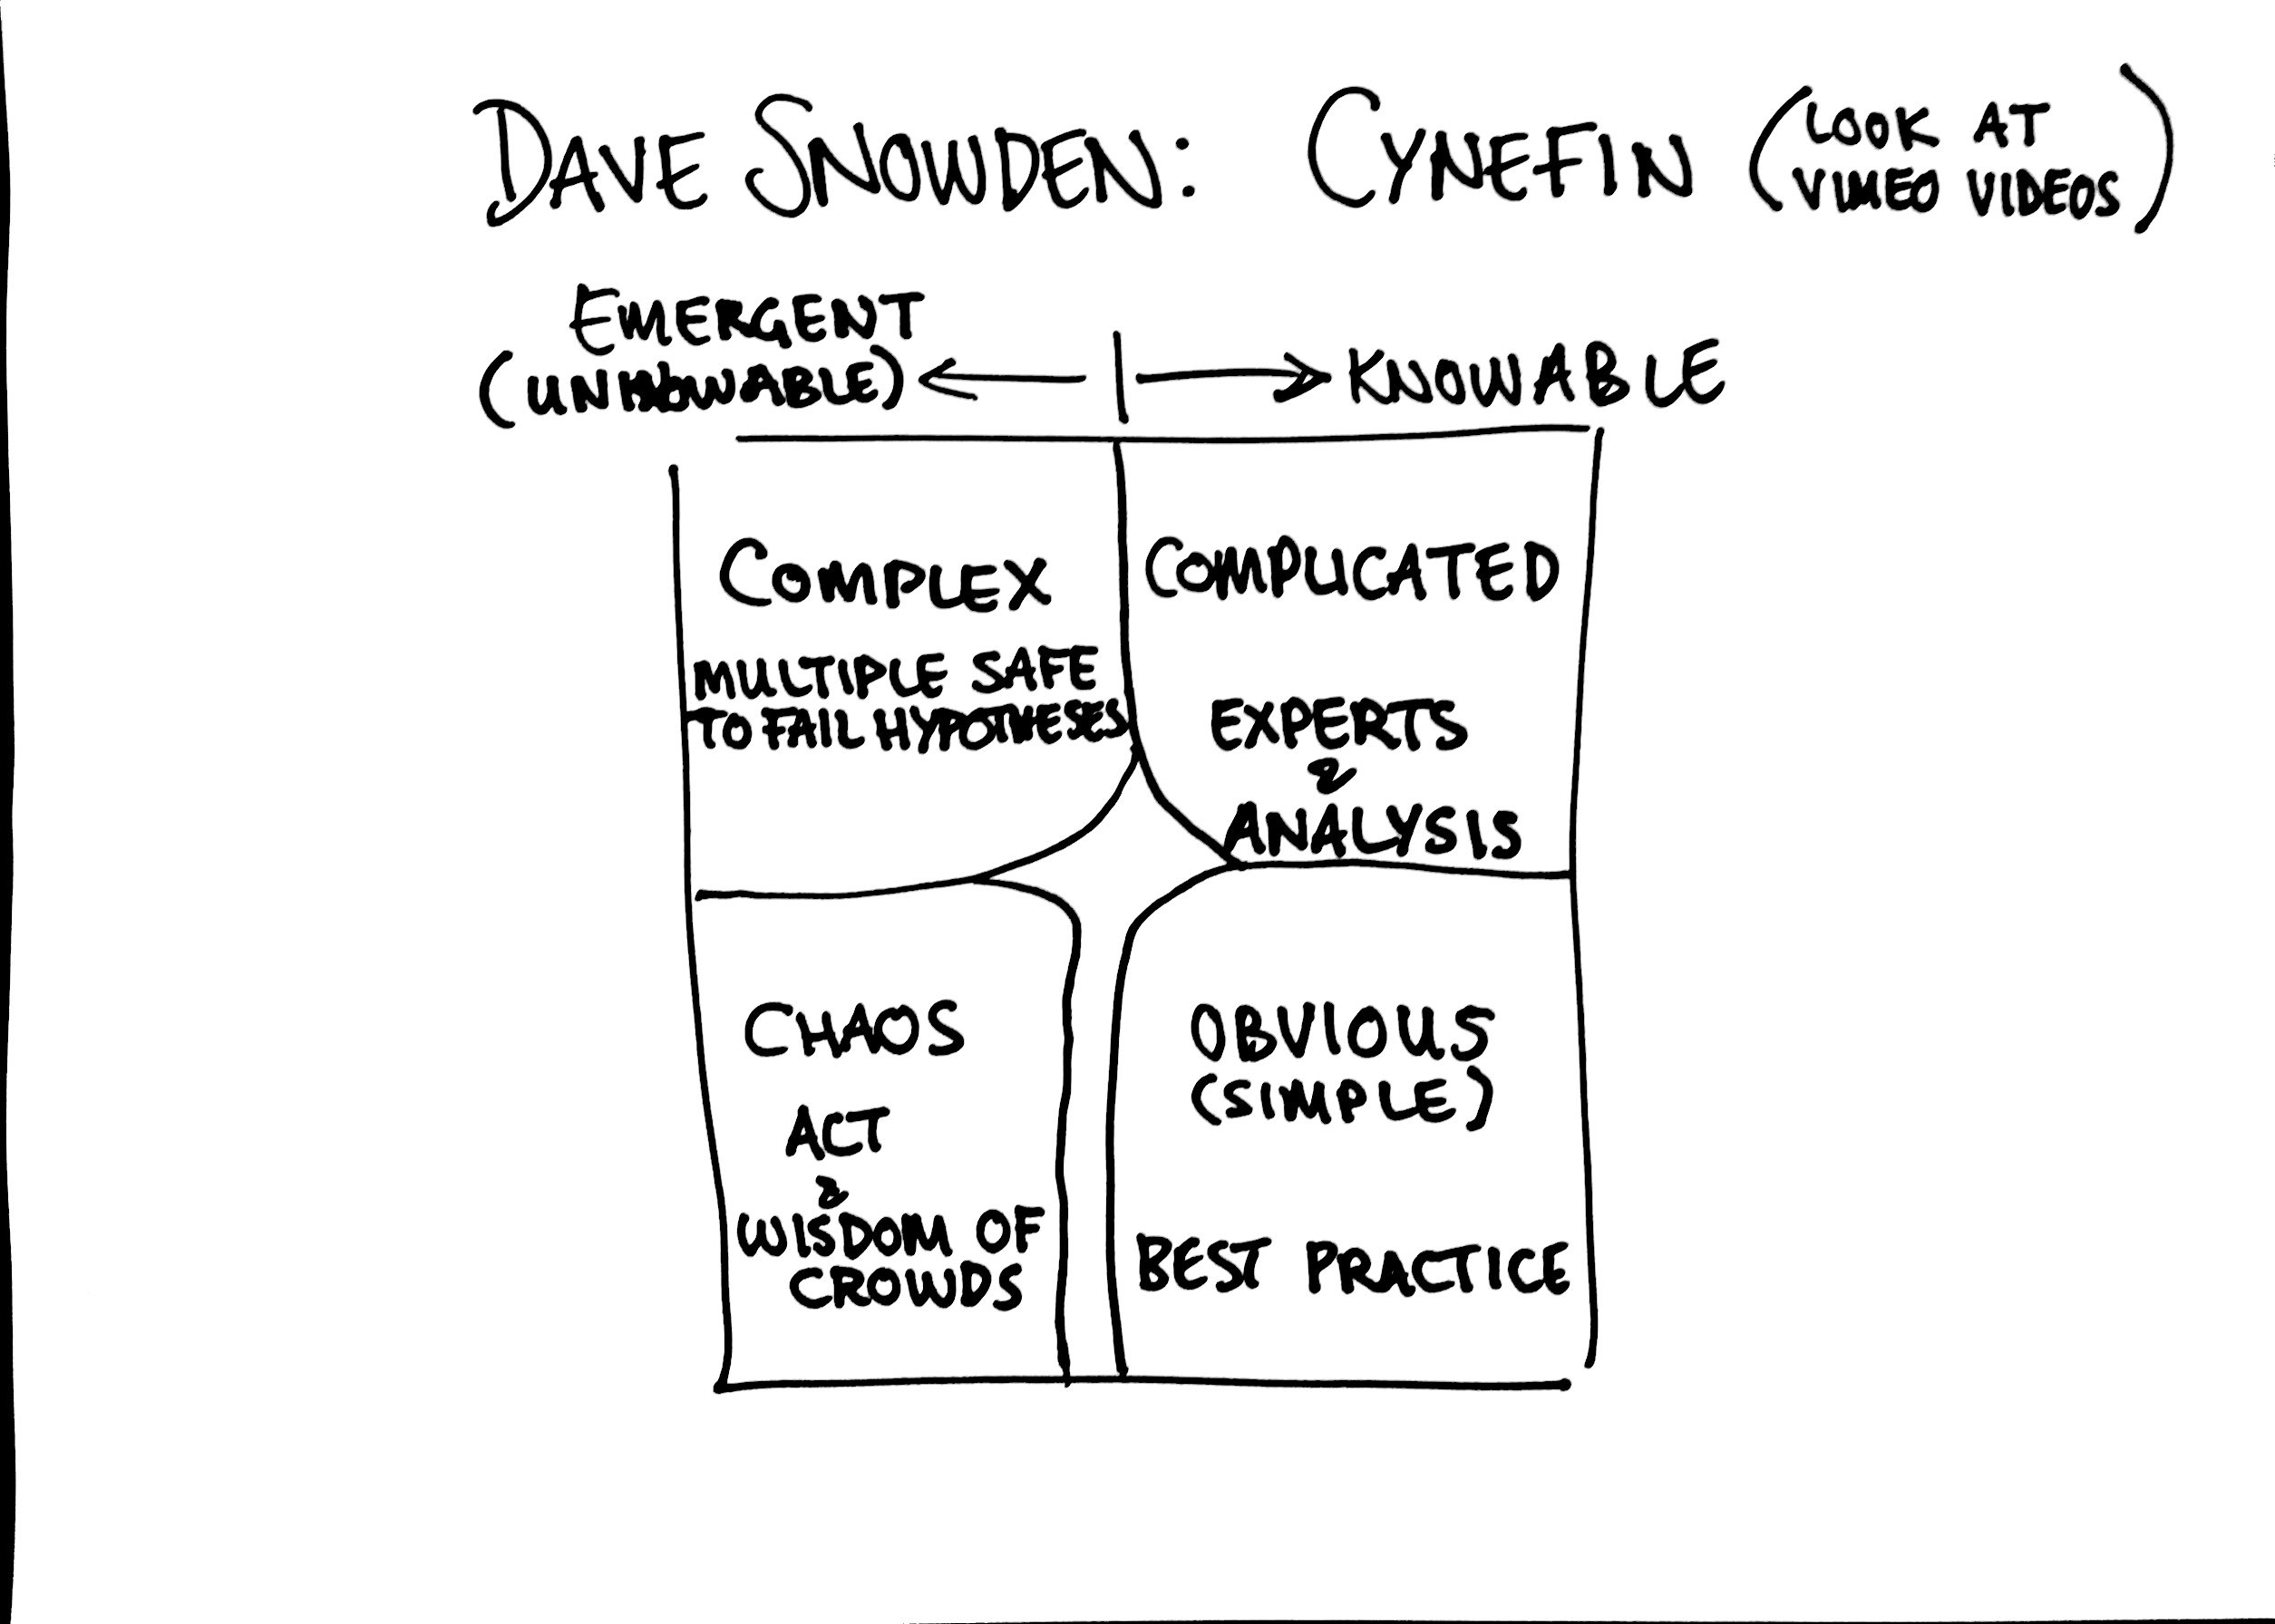

Slide 52
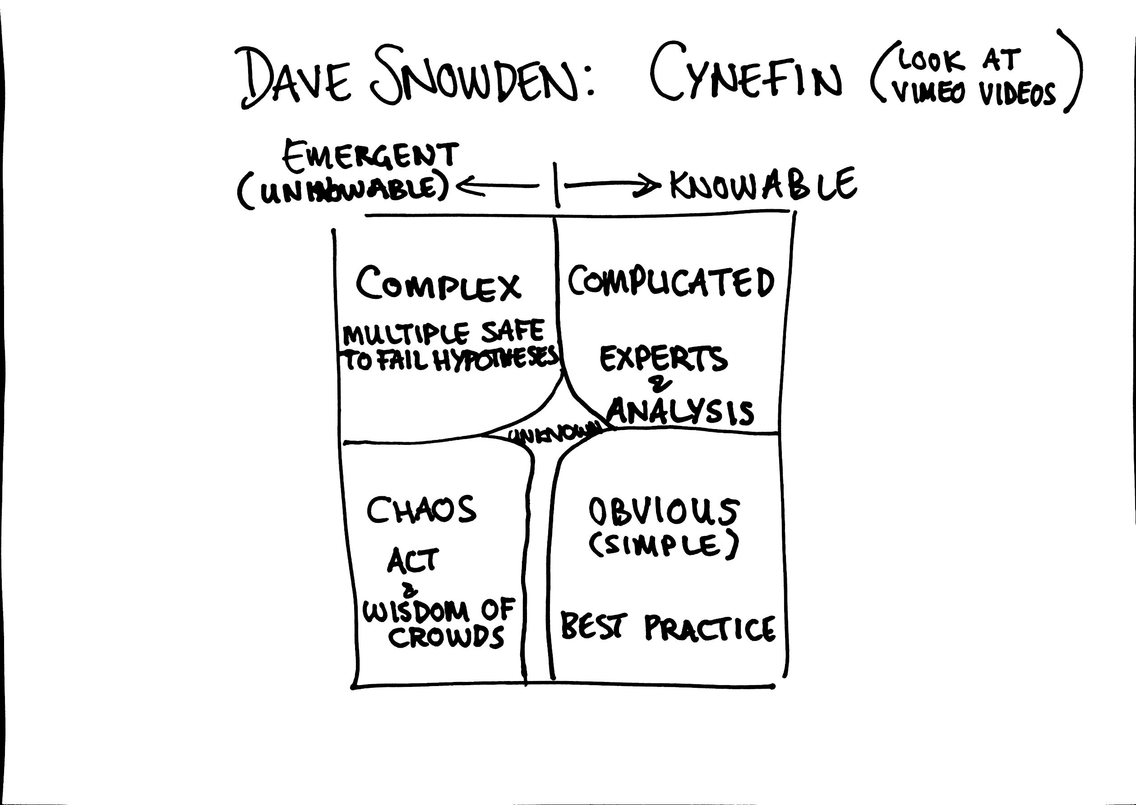

Slide 53
CUSTOMER
NEEDS
COST
SAVING
TECH DEBT
INNOVATION
REGULATORY

Slide 54
CUSTOMER
NEEDS
COST
SAVING
Extreme care
when using
Cost of Delay
TECH DEBT
Cost of Delay
Is appropriate
INNOVATION
REGULATORY

Slide 55
Customers
Churn
New Customers
People into
Funnel
Conversion
Ease of Use

Slide 57

https://pixabay.com/en/startup-start-up-people-593341/

Slide 58
2M
2M
1M

Slide 63
40 mins

Slide 65
2M
2M
1M

Slide 66
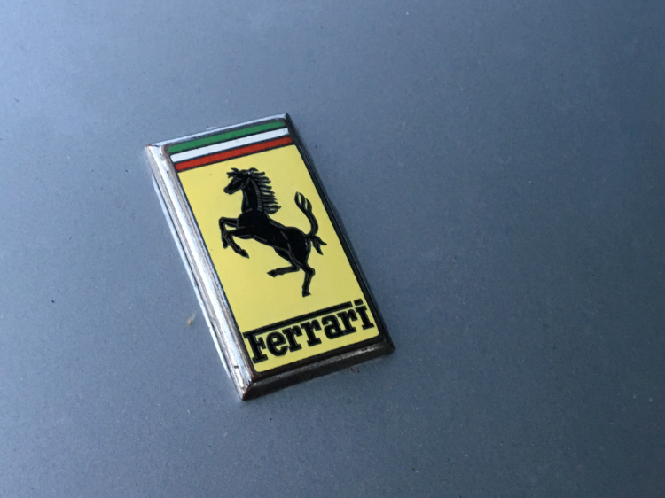

Slide 68
Notes:
We have a prize.

Slide 69
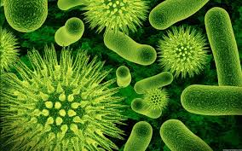

Slide 70
IT Projects☒
Business
Investment
Involving IT☑

Slide 71
@PapaChrisMatts
theITRiskManager.wordpress.com

Slide 72
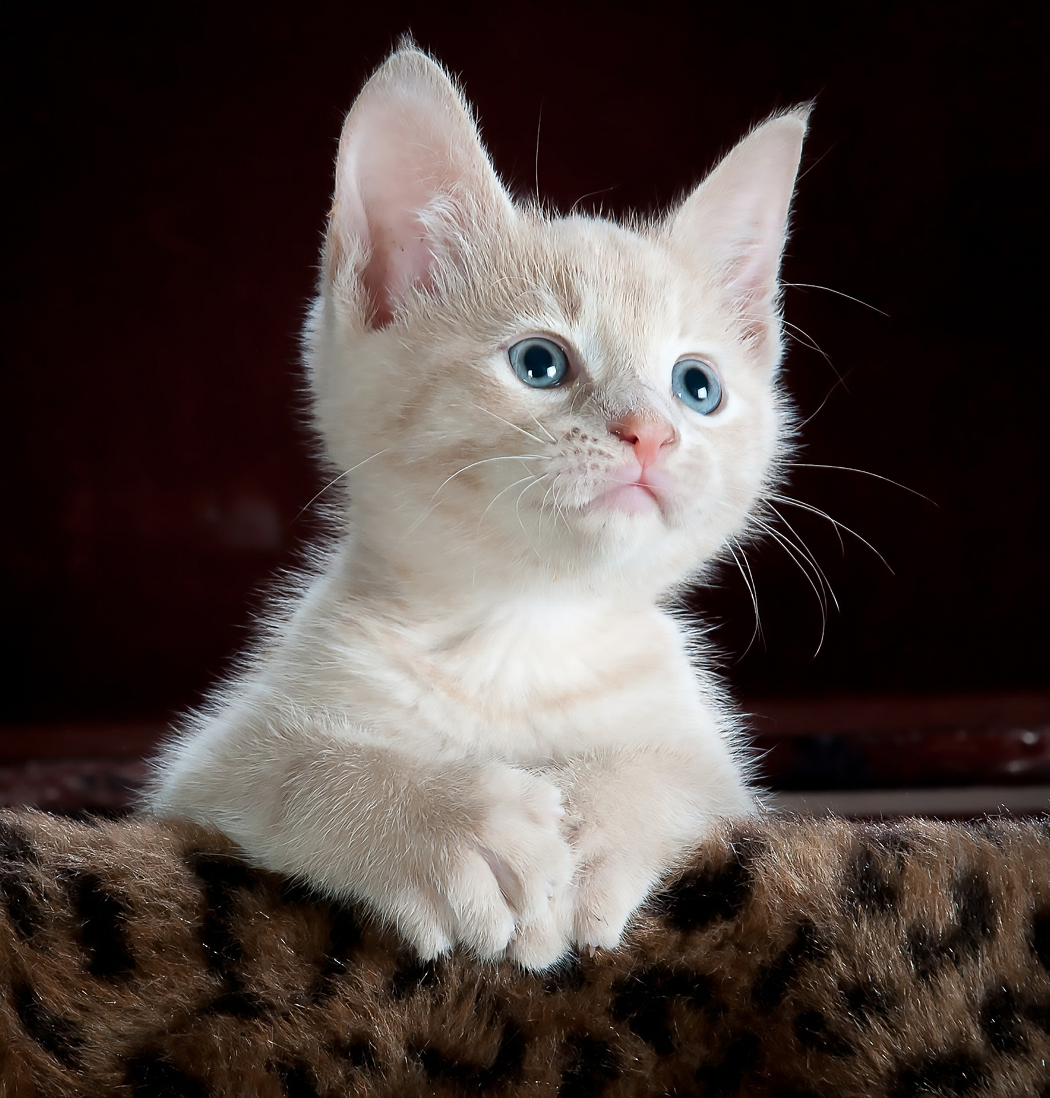
#ContentNotCats

