Slide 1

Spying on the most dangerous
animals in the Amazon…
Lions,
Piranhas &
Customers
theITRiskManager.wordpress.com
@PapaChrisMatts

Slide 2







Slide 3
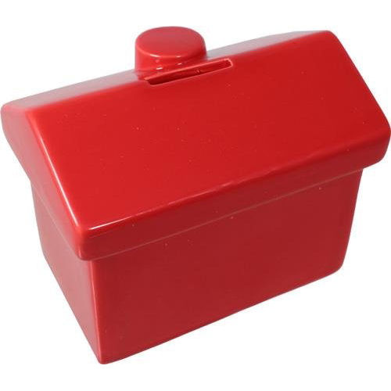

Slide 4
Why do we do Agile?
Please discuss in pairs for two minutes.

Slide 5
Analysis
Design
Code
Test
Prod

Slide 7
Analysis
Design
Code
Test
Prod

Slide 8
Analysis
Design
Code
Test
Prod
Kevin Tate

Slide 9
5 mins

Slide 10

http://corporate.dominos.co.uk

Slide 11

Imdb.com

Slide 12
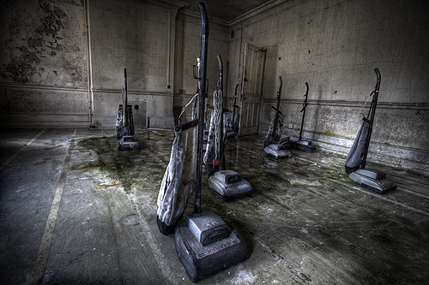

Slide 13
Analysis
Design
Code
Test
Prod

Slide 14
IT Projects☒

Slide 15
IT Investments☑

Slide 16
Imdb.com

Slide 17
10 mins

Slide 18
How do we do product development?
Please discuss in pairs for two minutes.

Slide 19
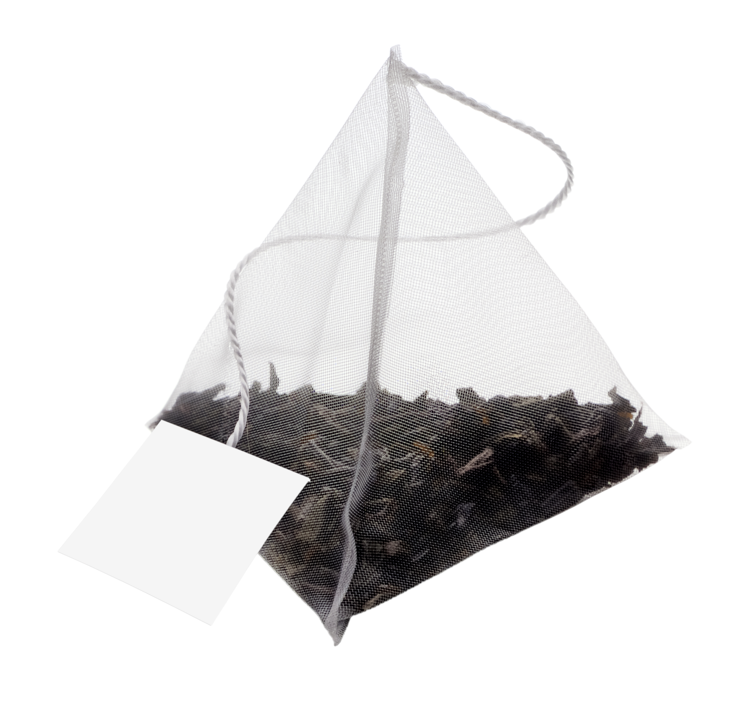

Slide 20


Slide 21


Slide 22


Slide 23


Slide 24


Slide 26
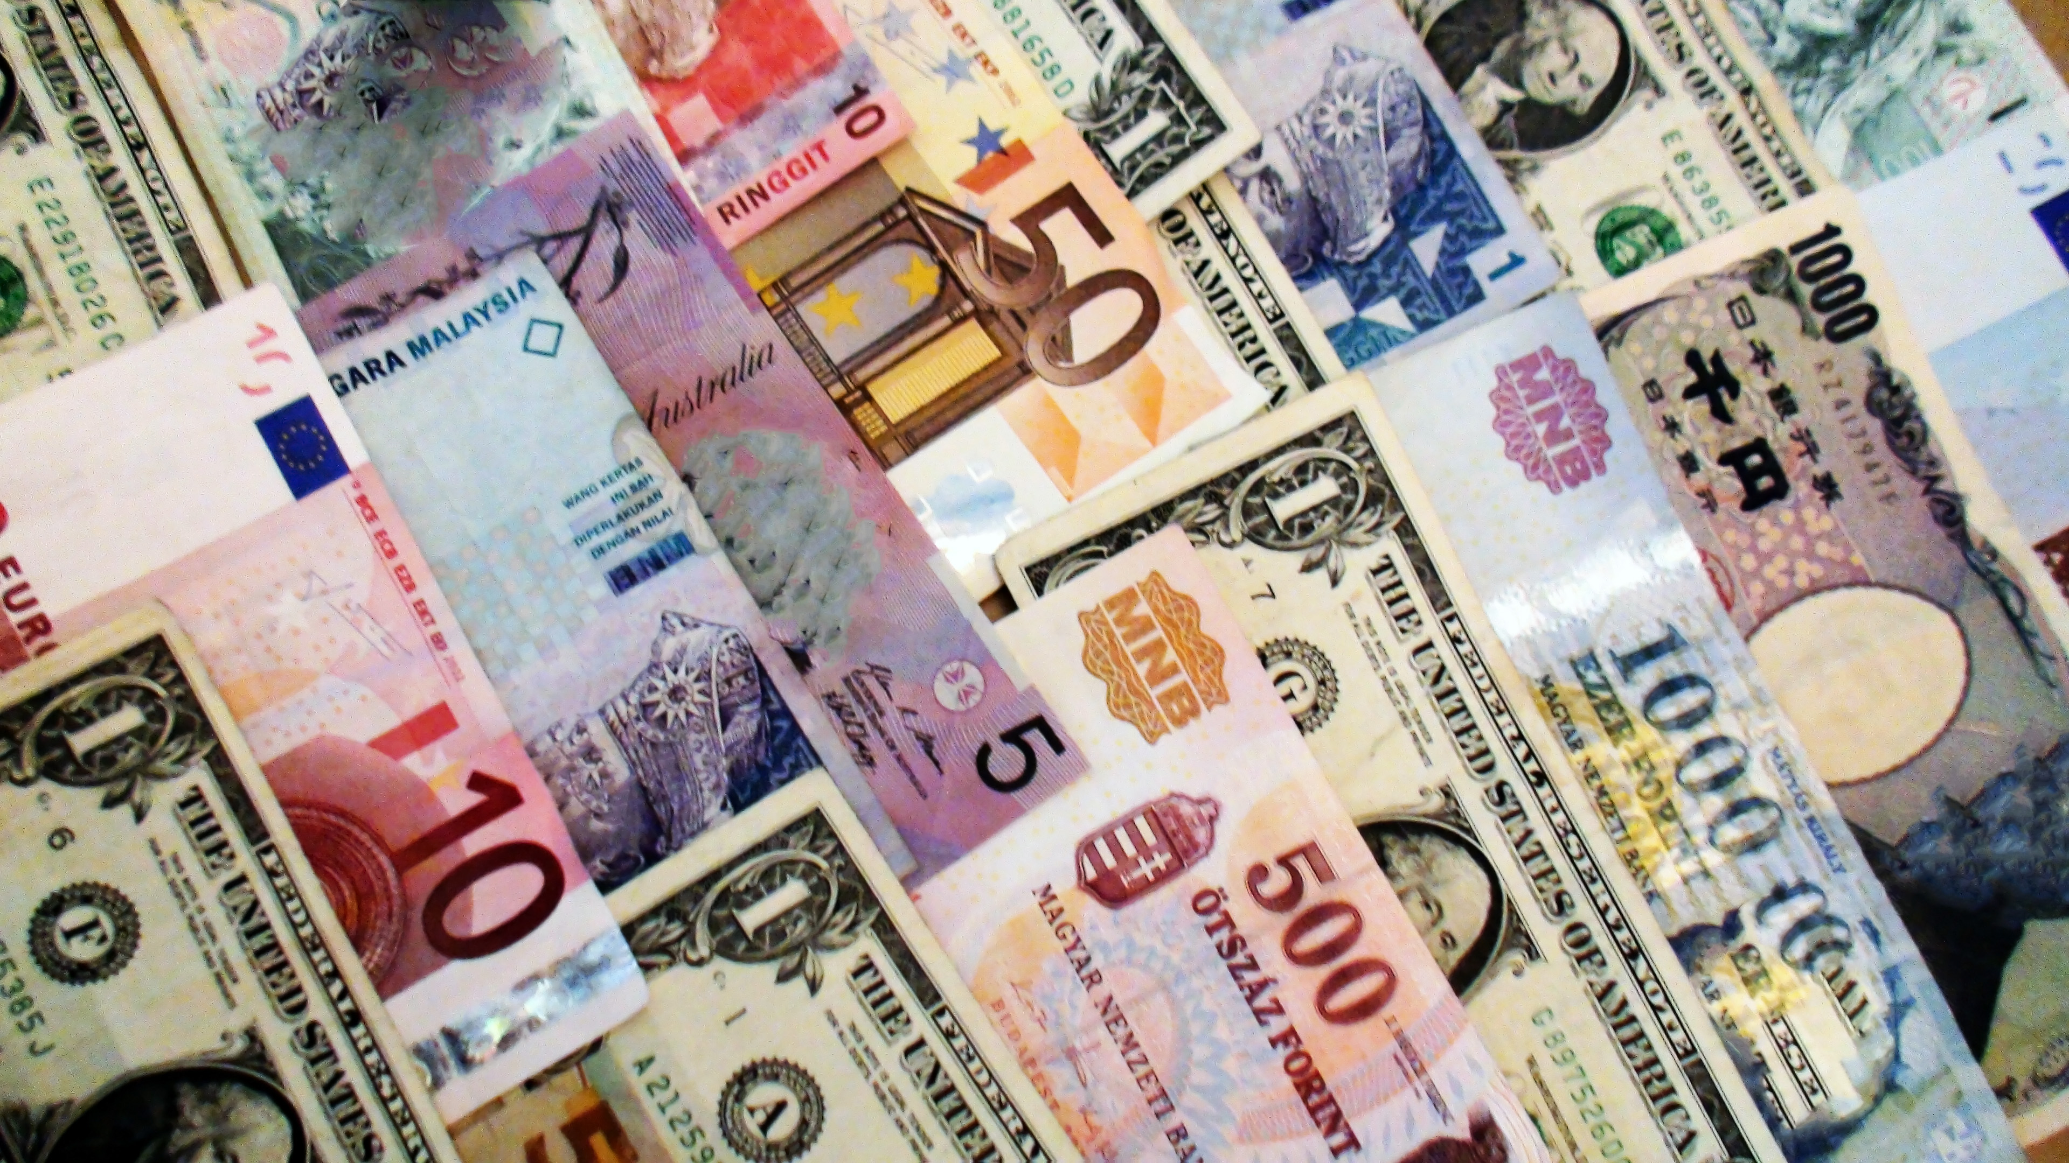

Slide 27
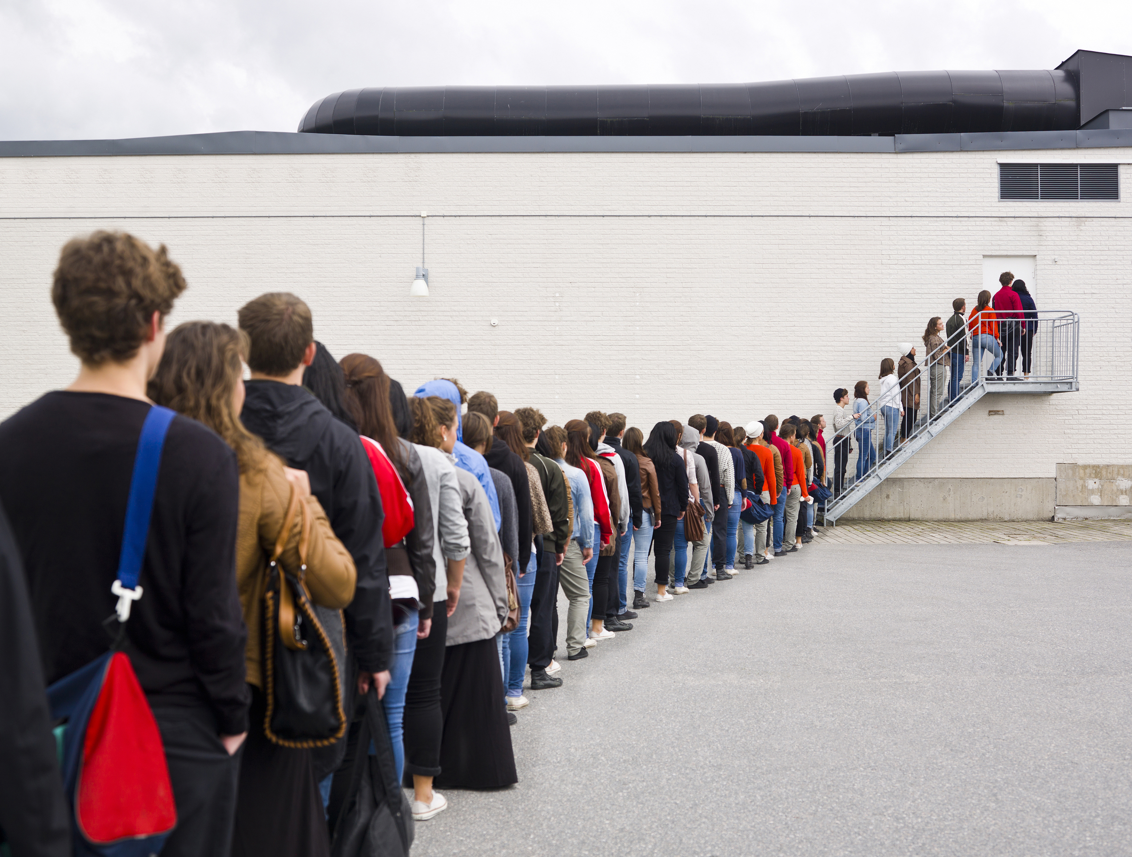

Slide 28


Slide 31
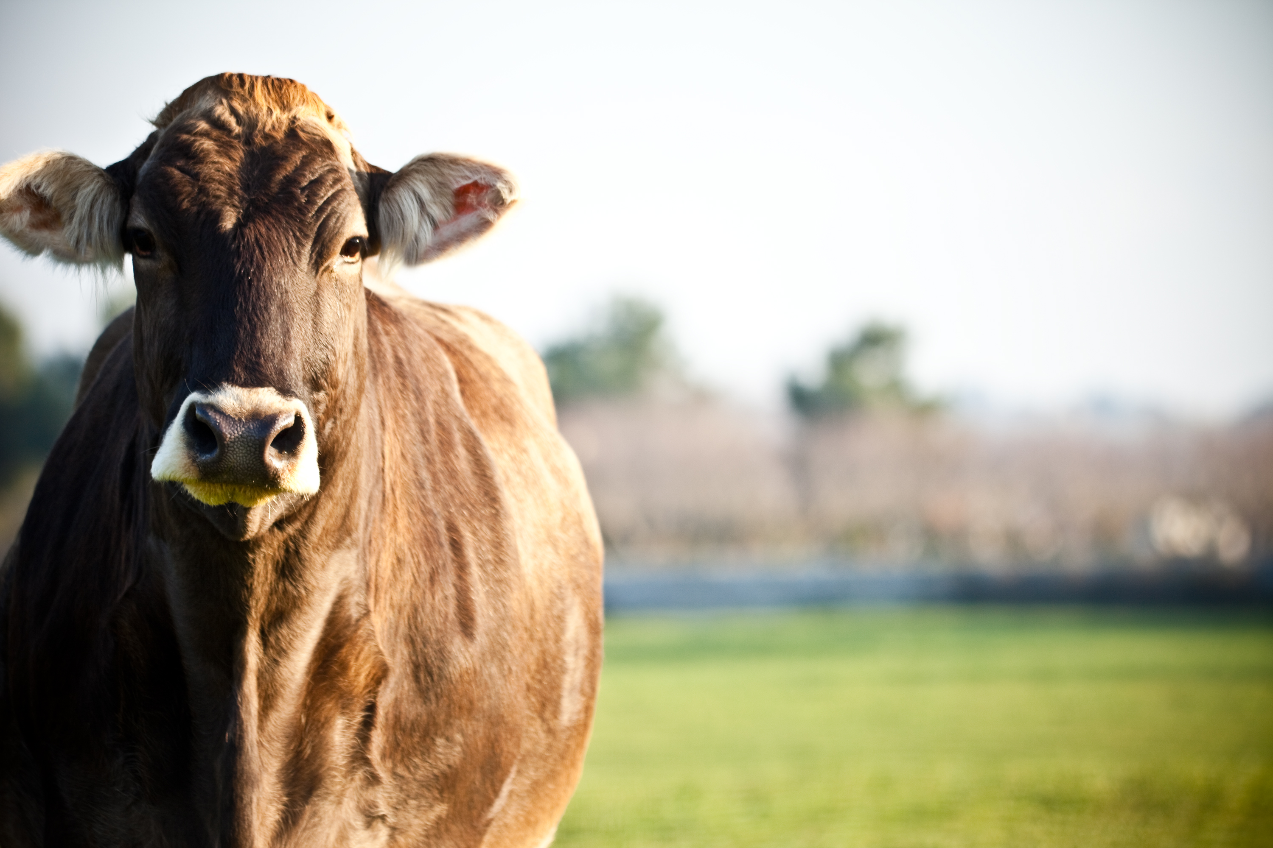

Slide 33
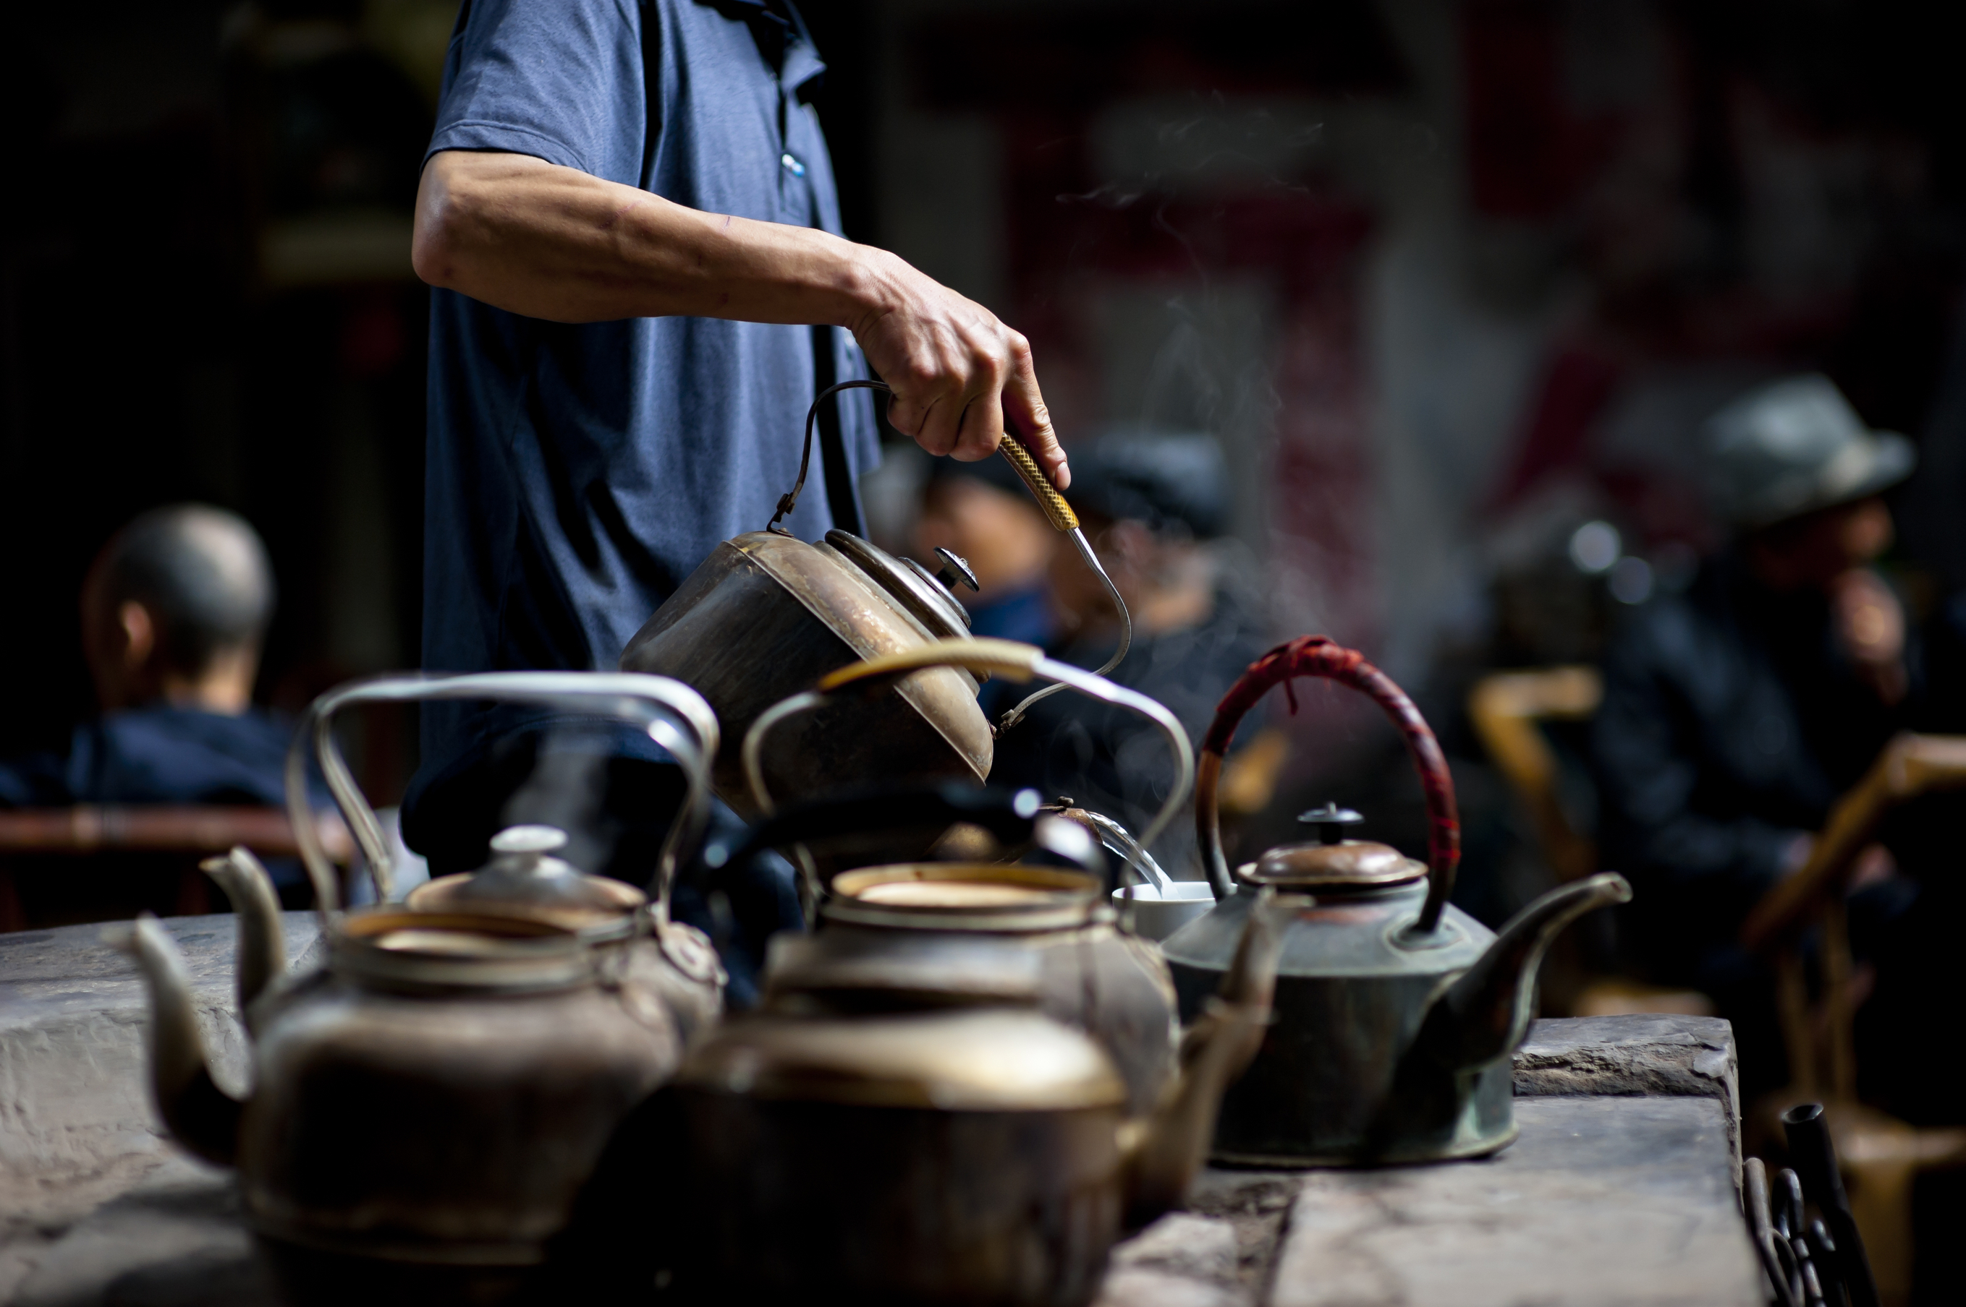

Slide 34
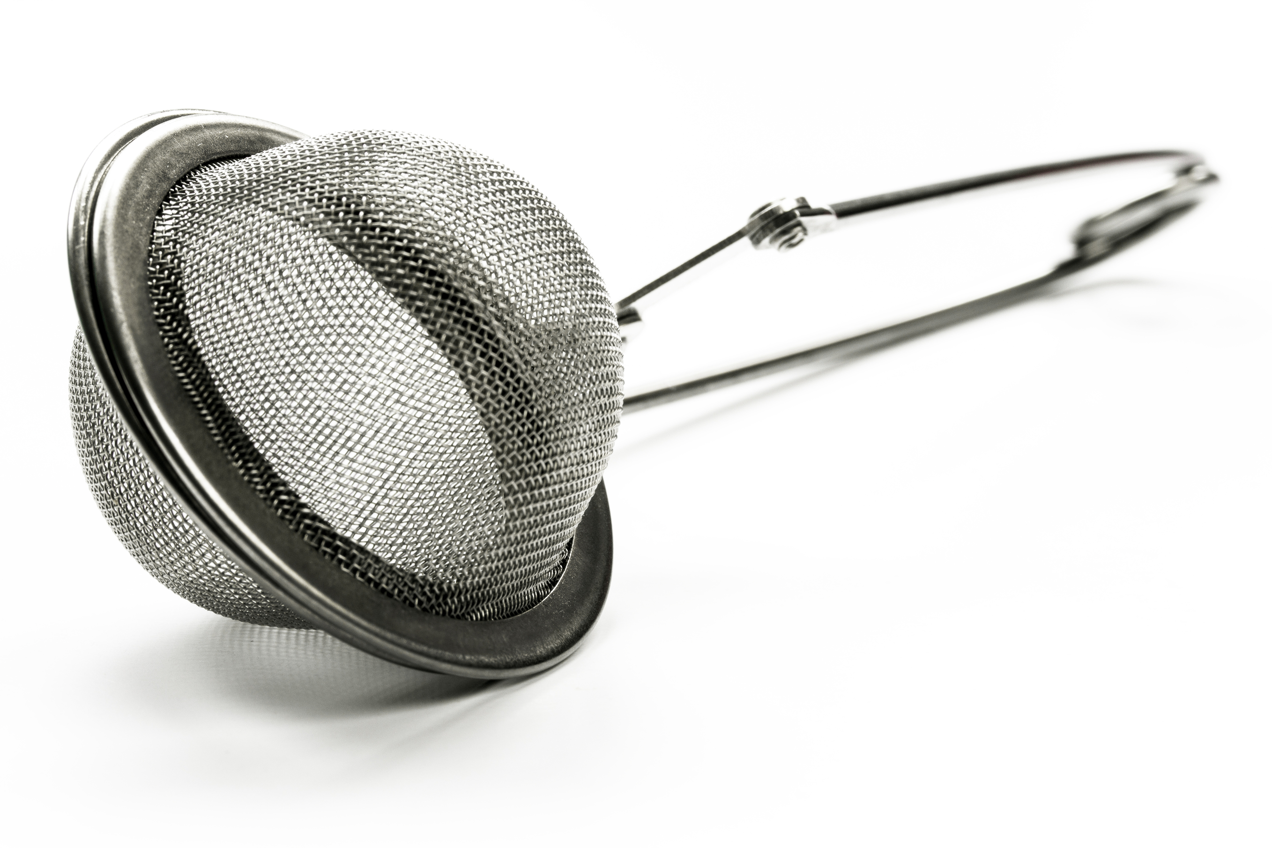

Slide 35


Slide 36
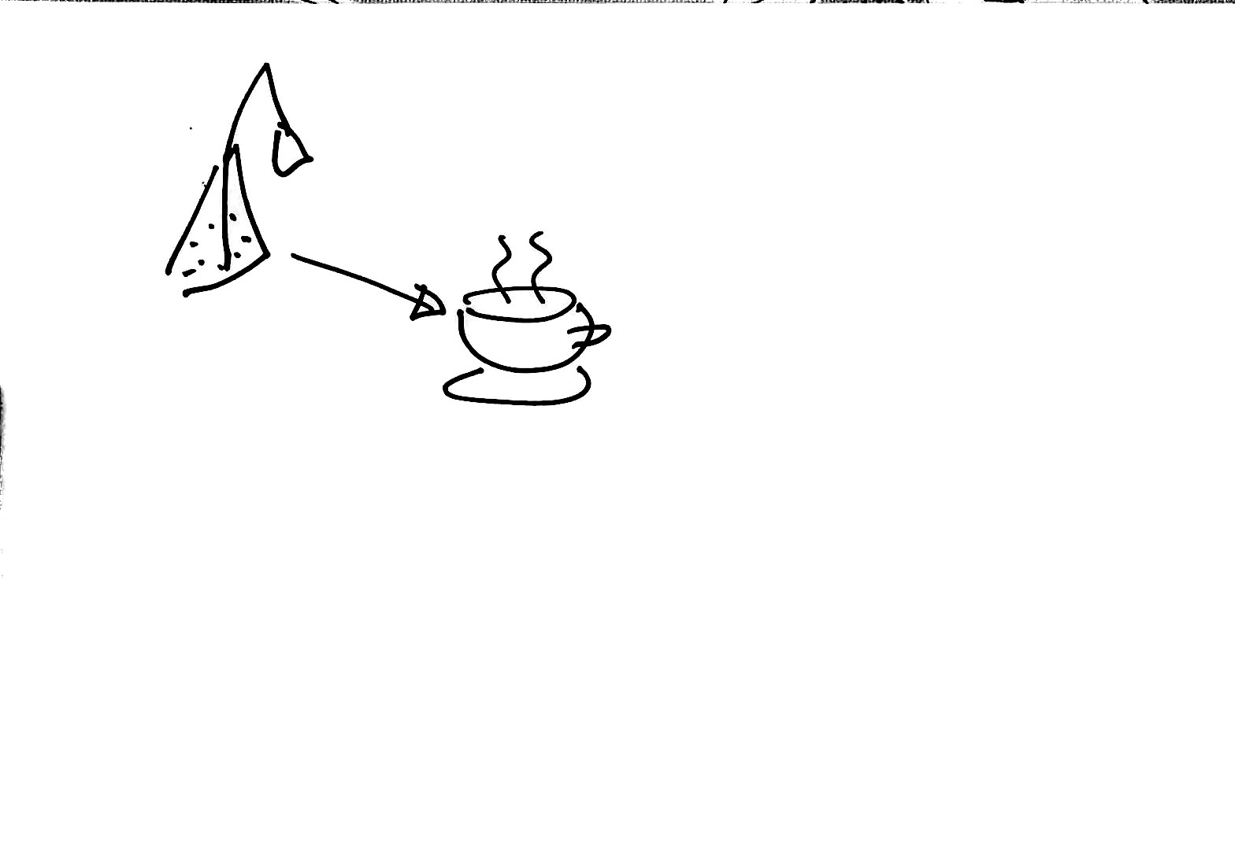

Slide 37
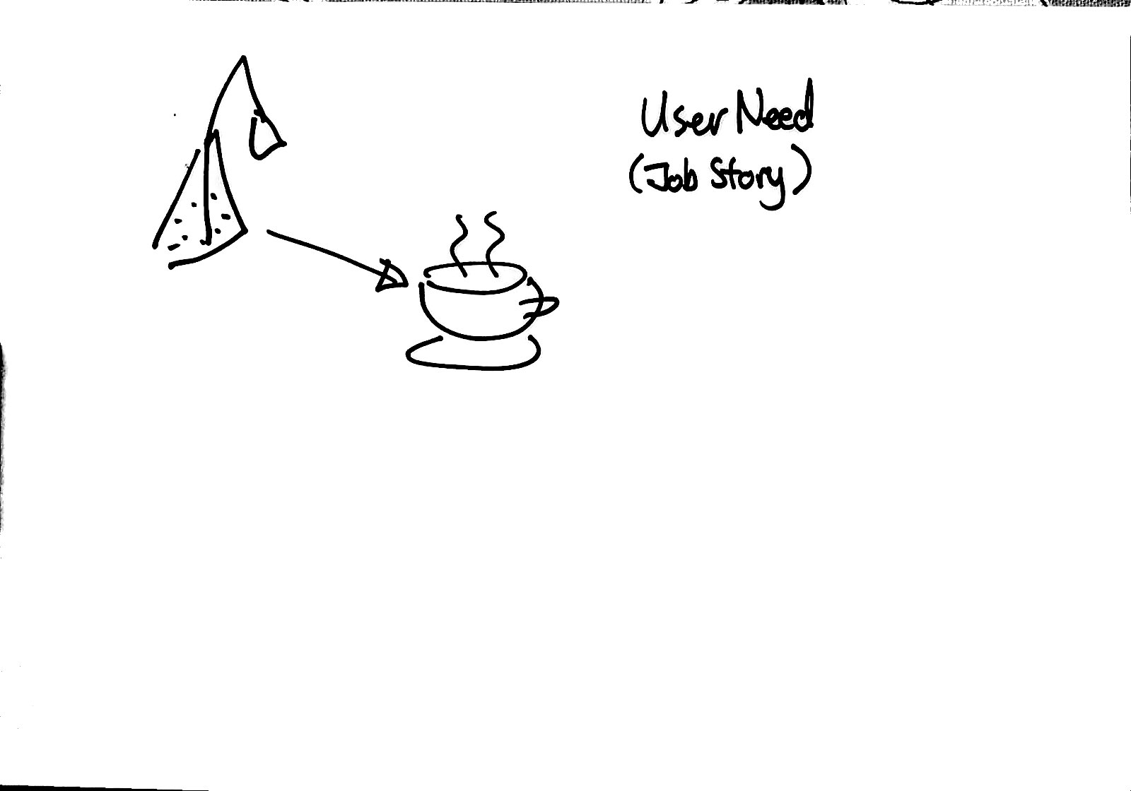

Slide 38
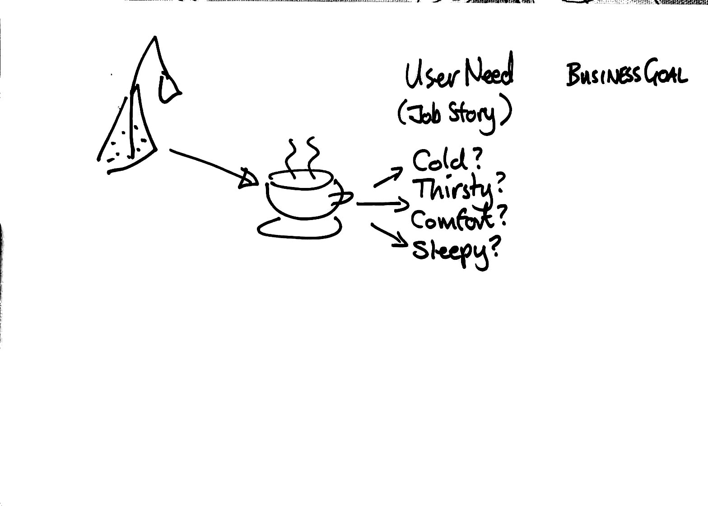

Slide 40
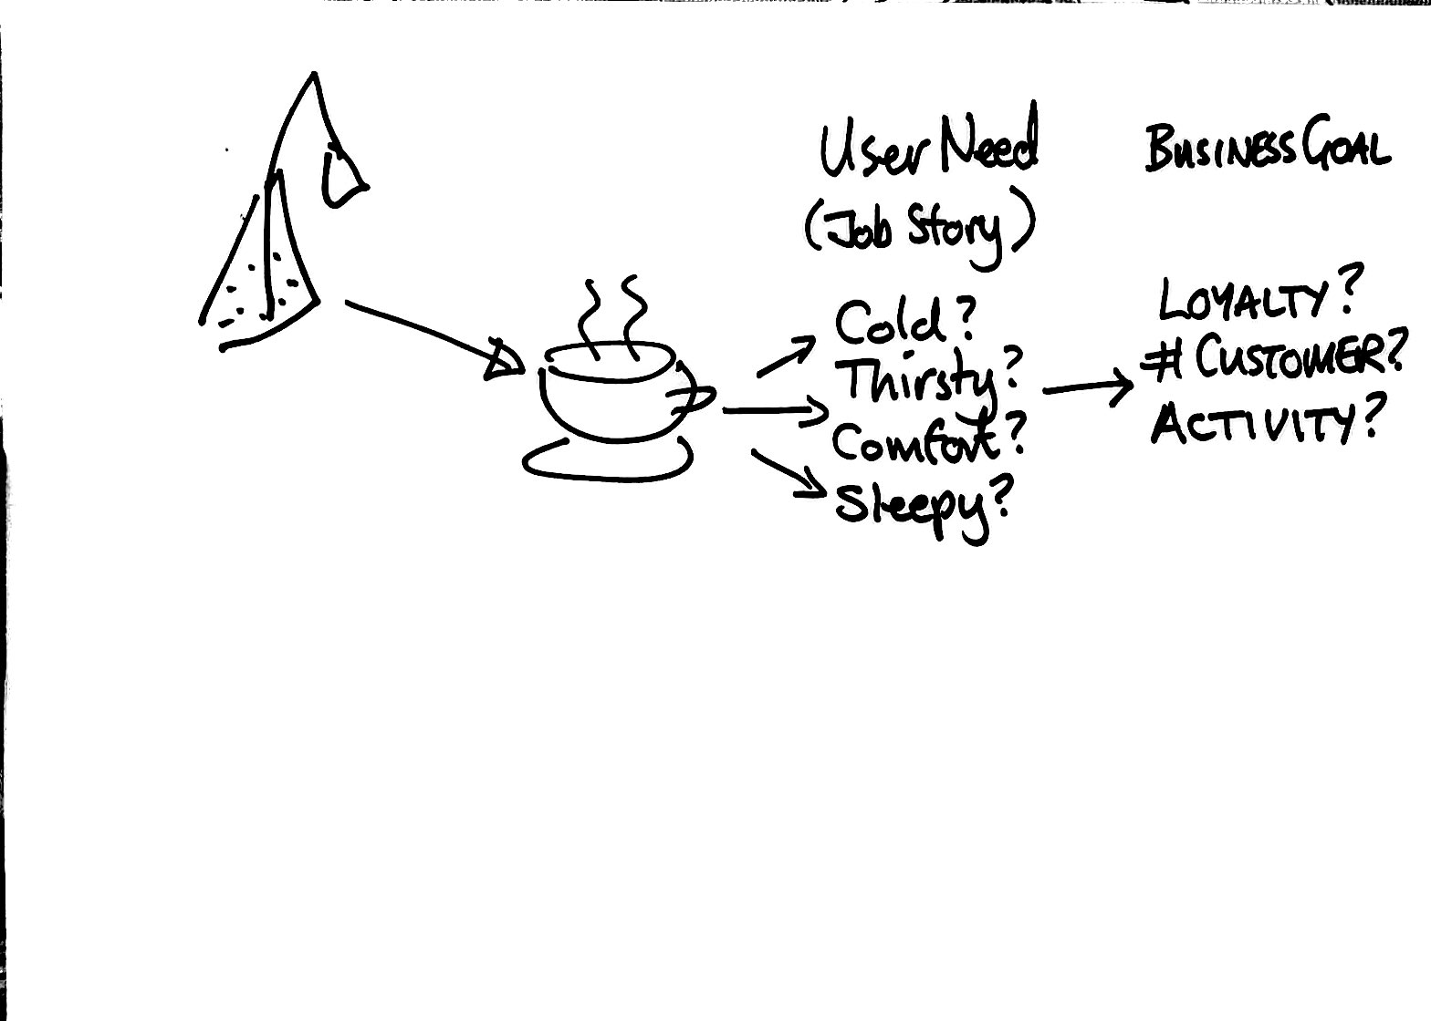

Slide 41
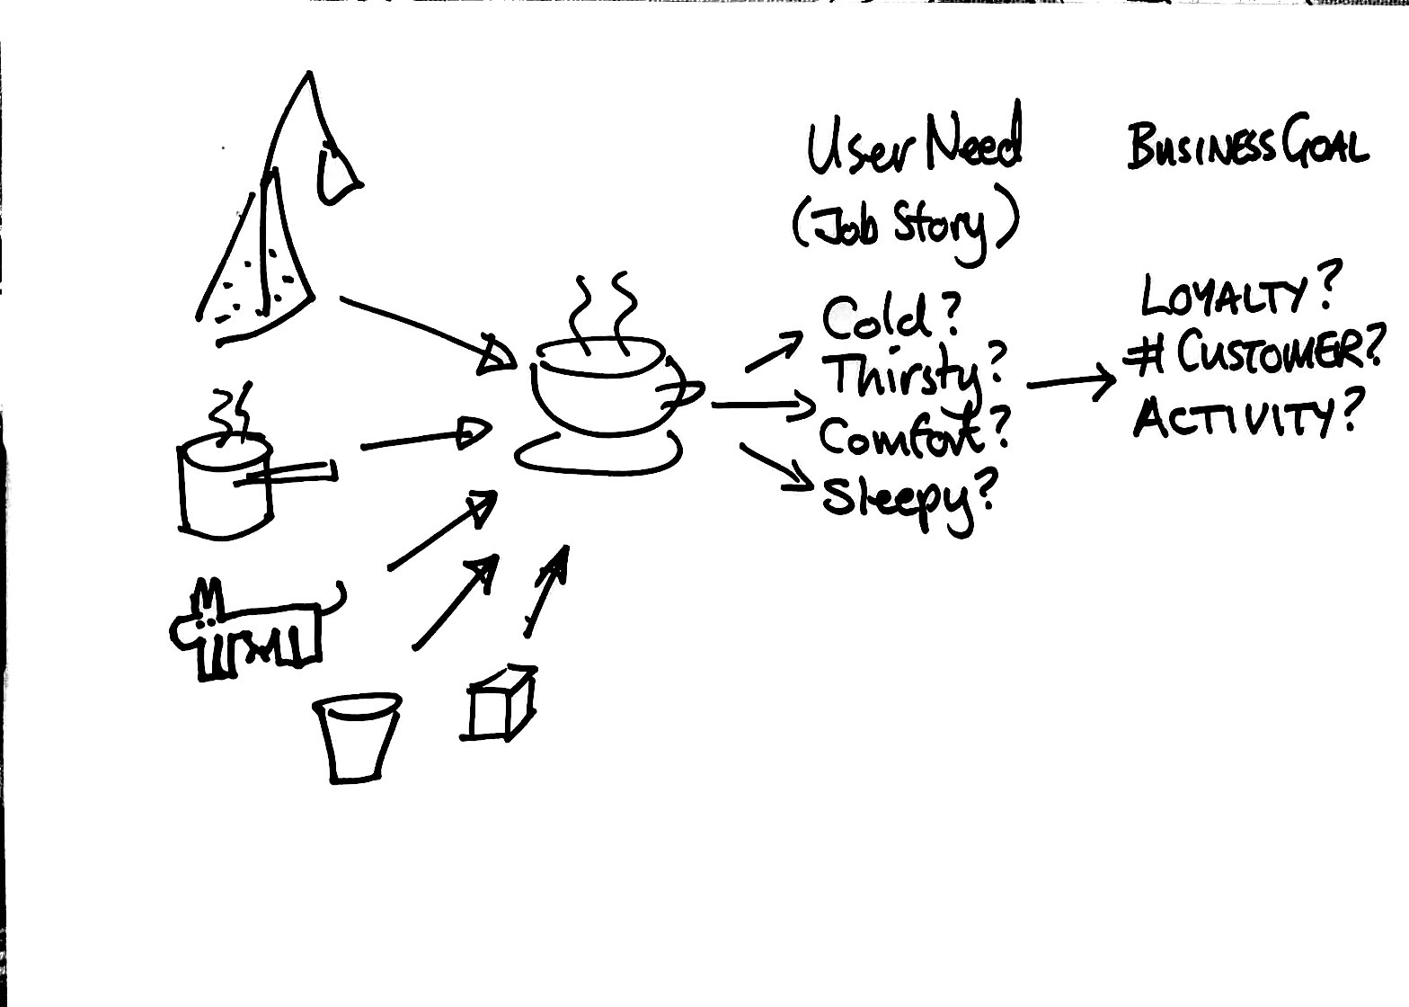

Slide 42
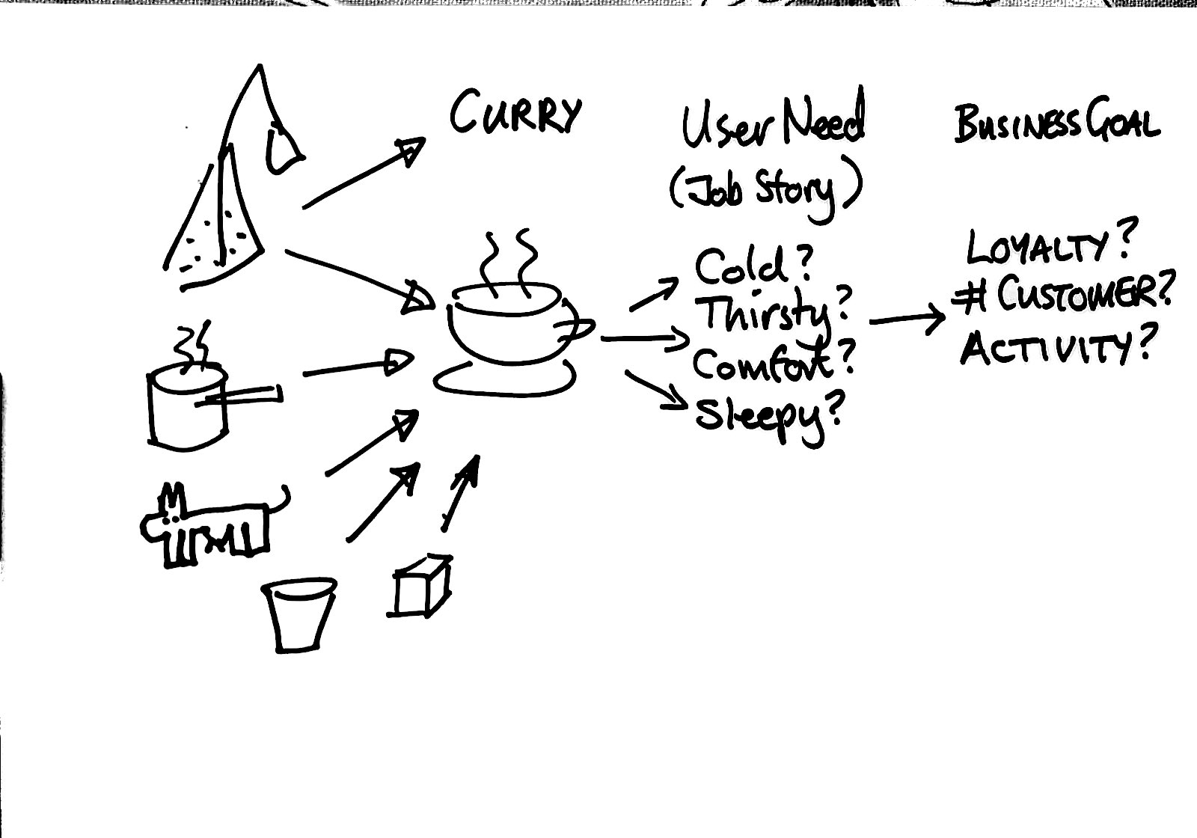

Slide 43
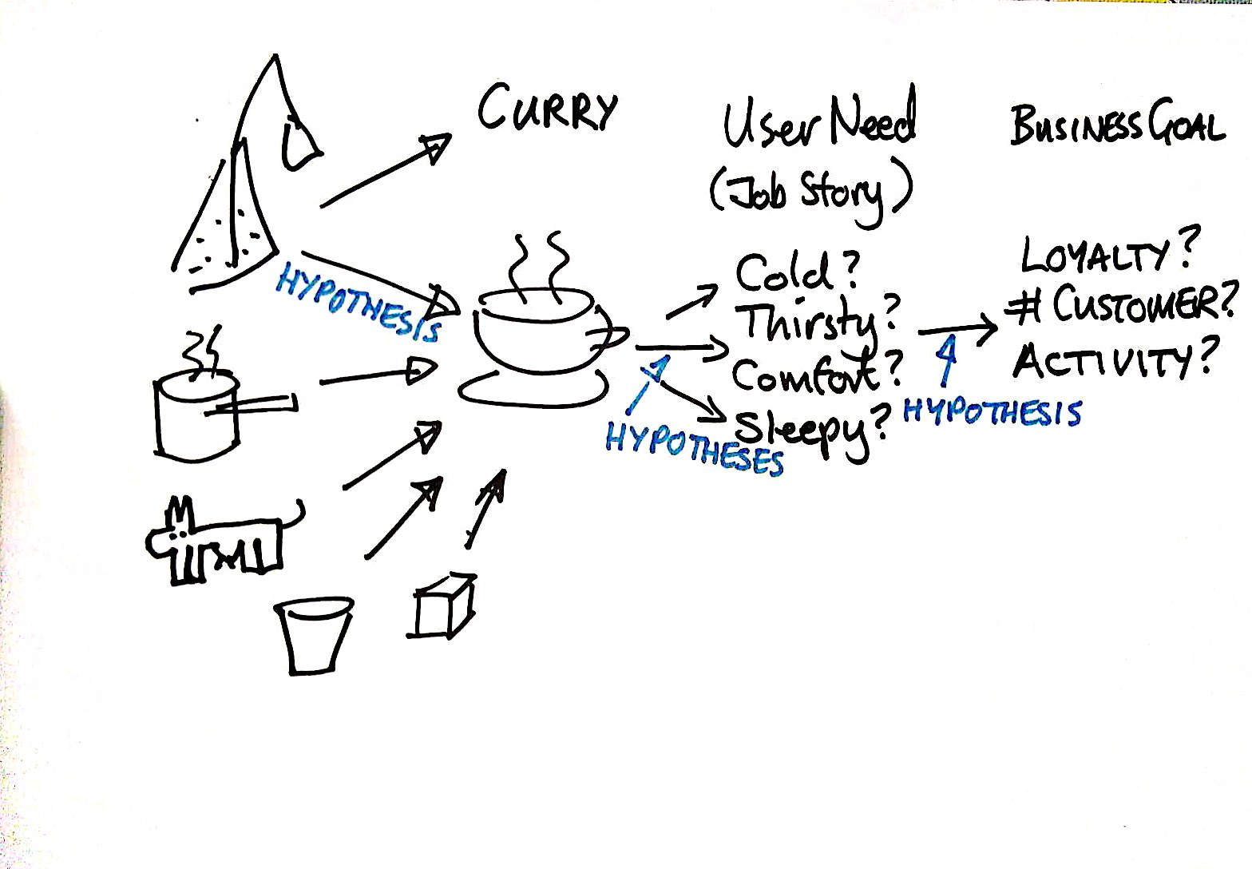

Slide 44
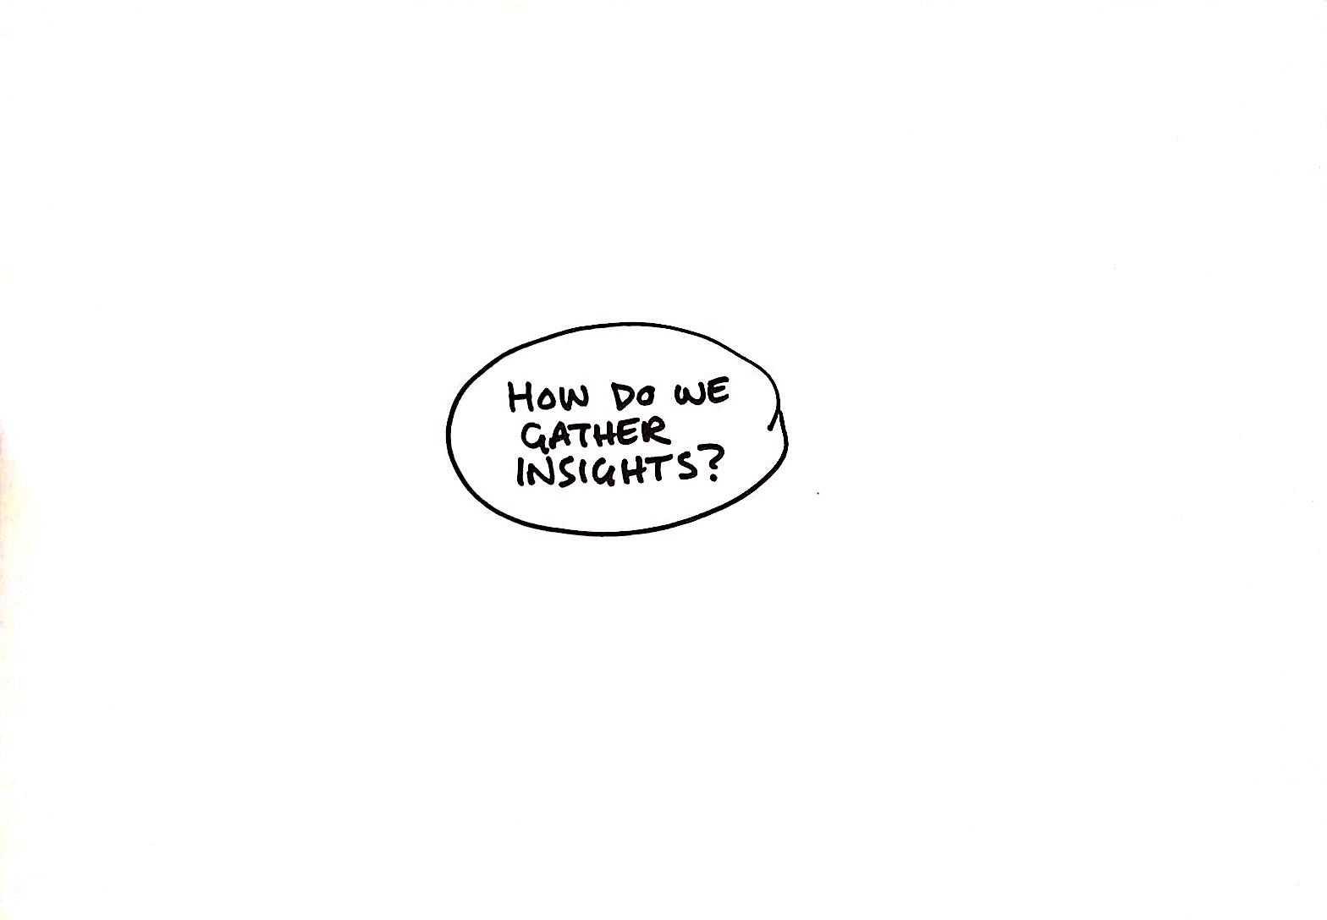

Slide 45
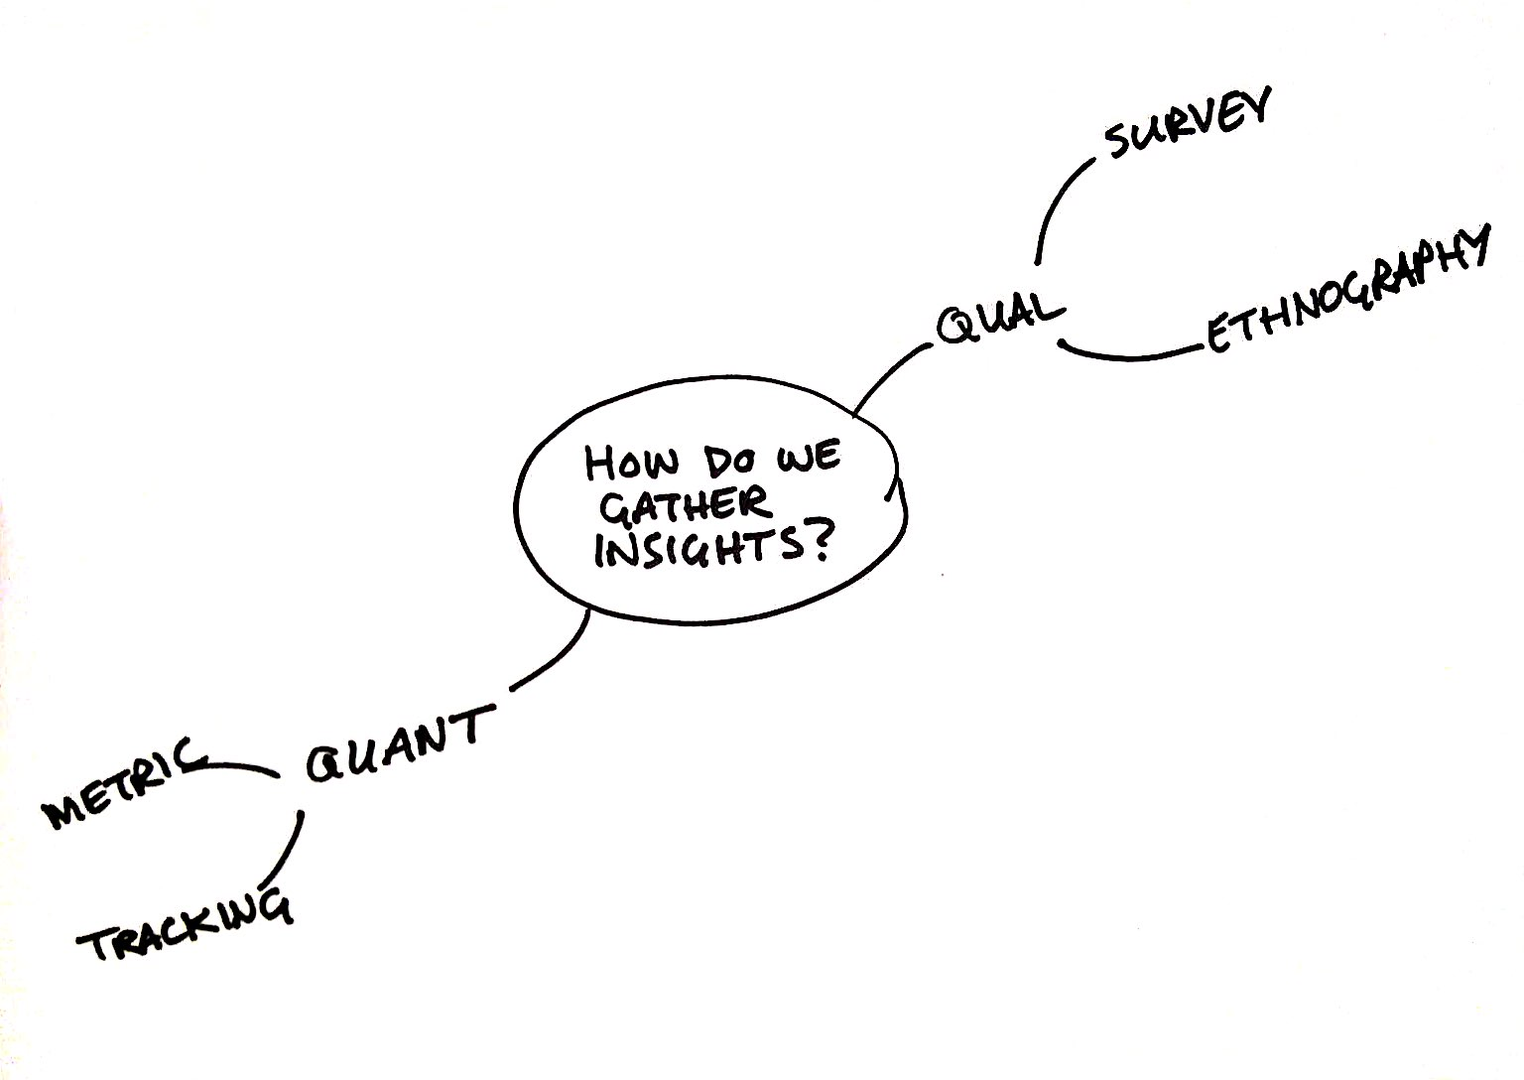

Slide 46
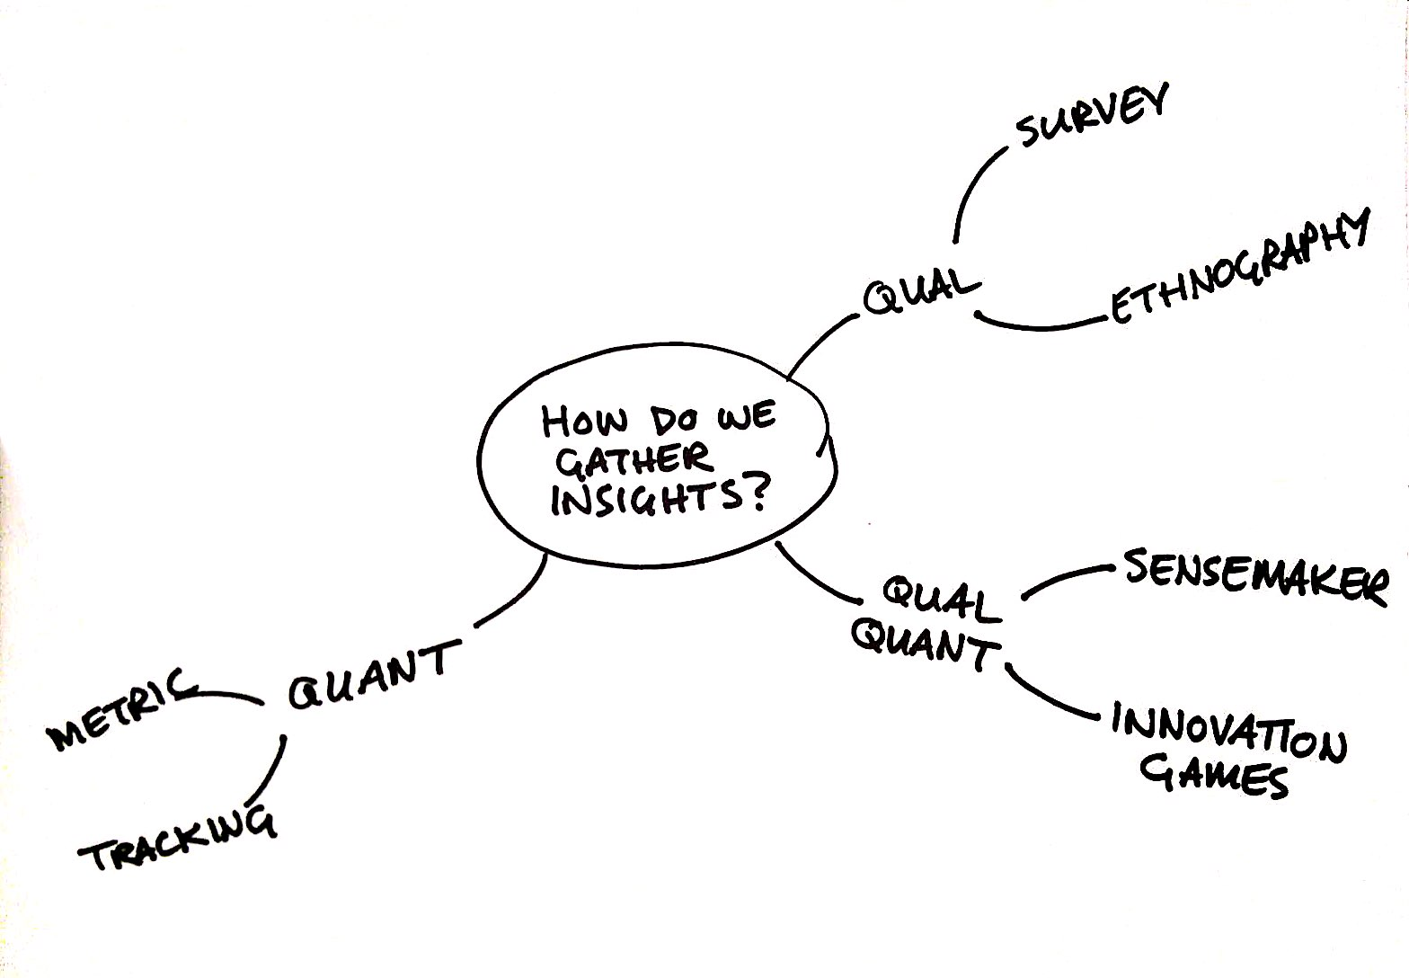

Slide 47
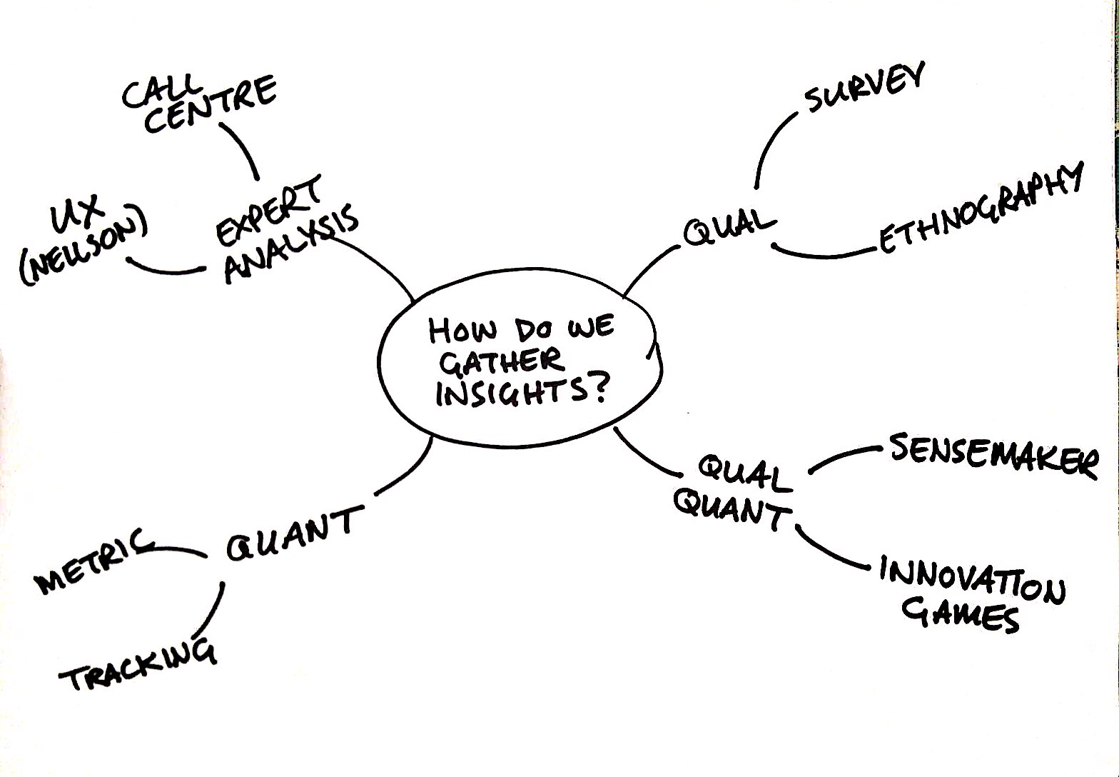

Slide 48
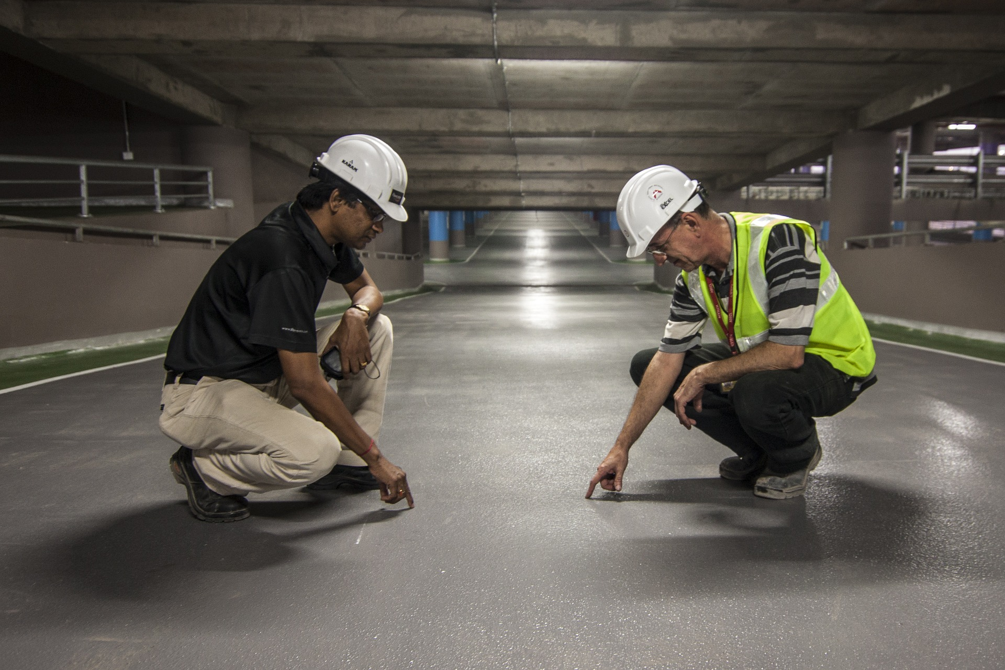

Slide 49
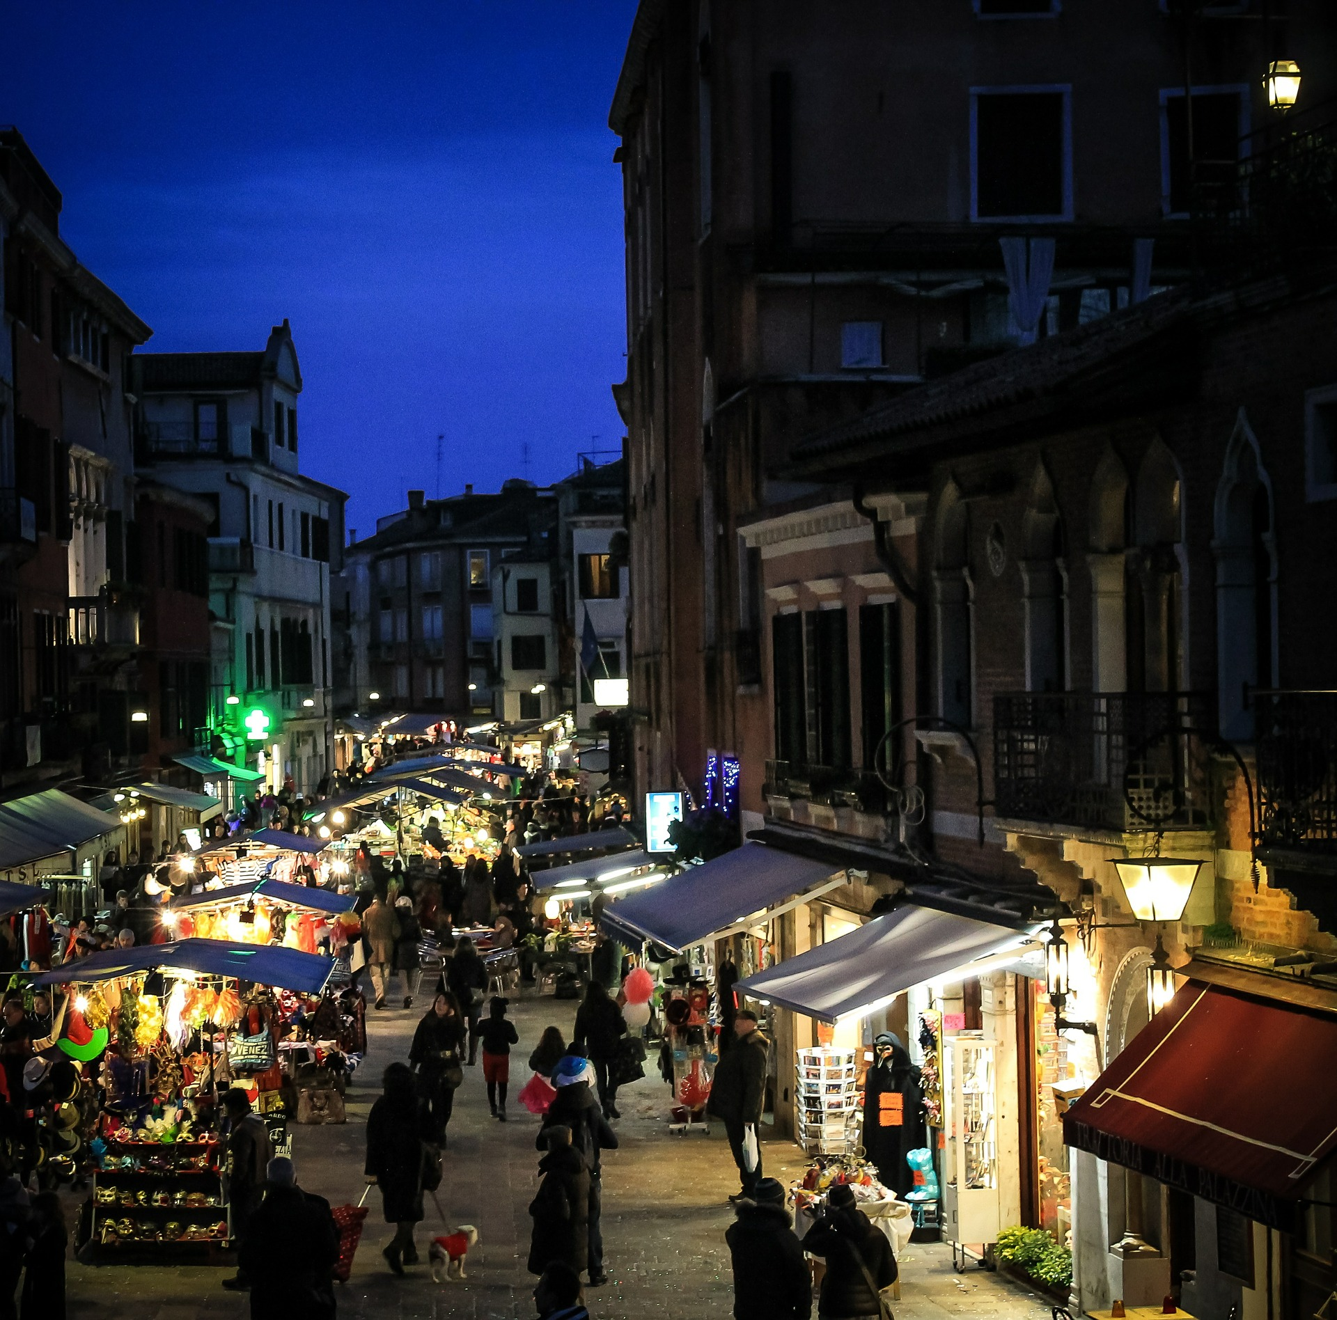
Notes:
Guerrilla test

Slide 50
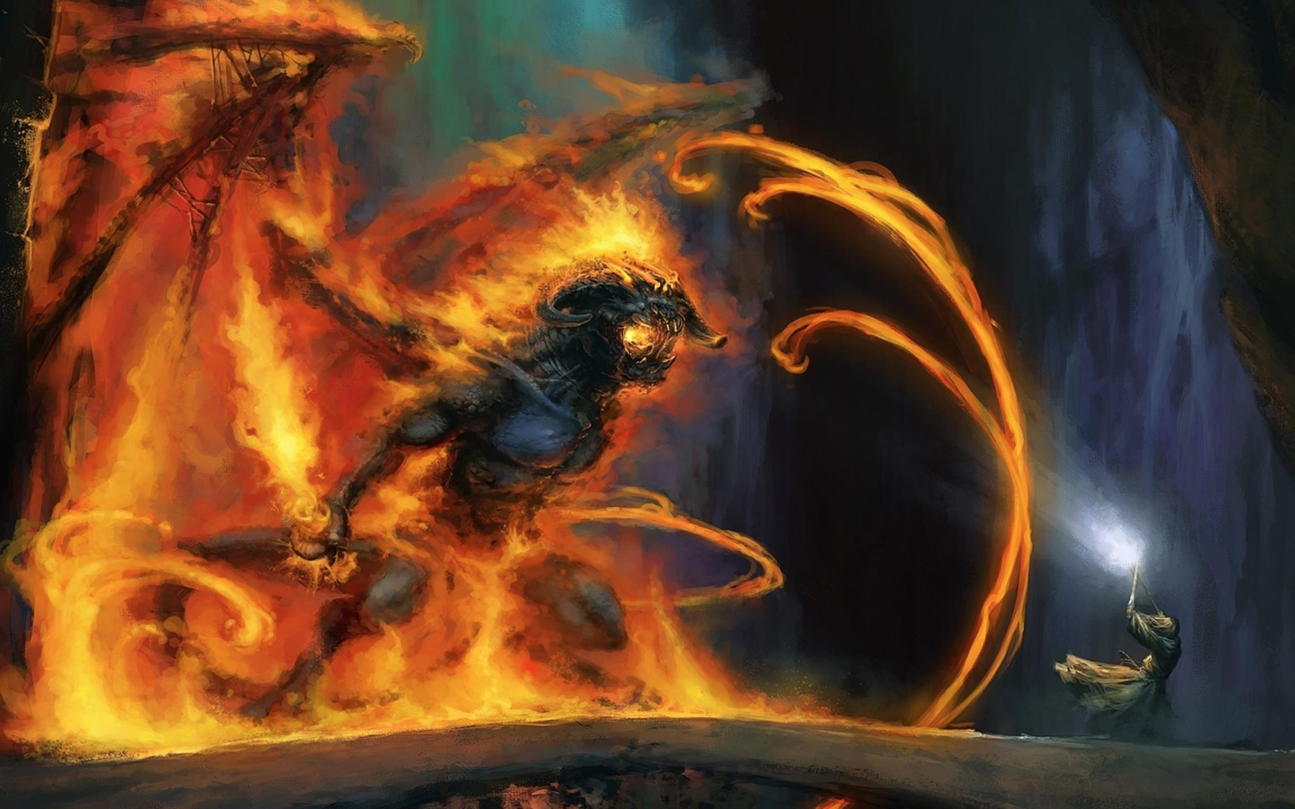
http://toppixgallery.com/gandalf-and-the-balrog/
Notes:
Risk say No!

Slide 52
☑

Slide 53
☒

Slide 54
☑

Slide 56


Slide 57
Customers
Churn
New Customers
People into
Funnel
Conversion
Ease of Use

Slide 58
Notes:
New release had bug. Not restart when machine switched off.

Slide 59
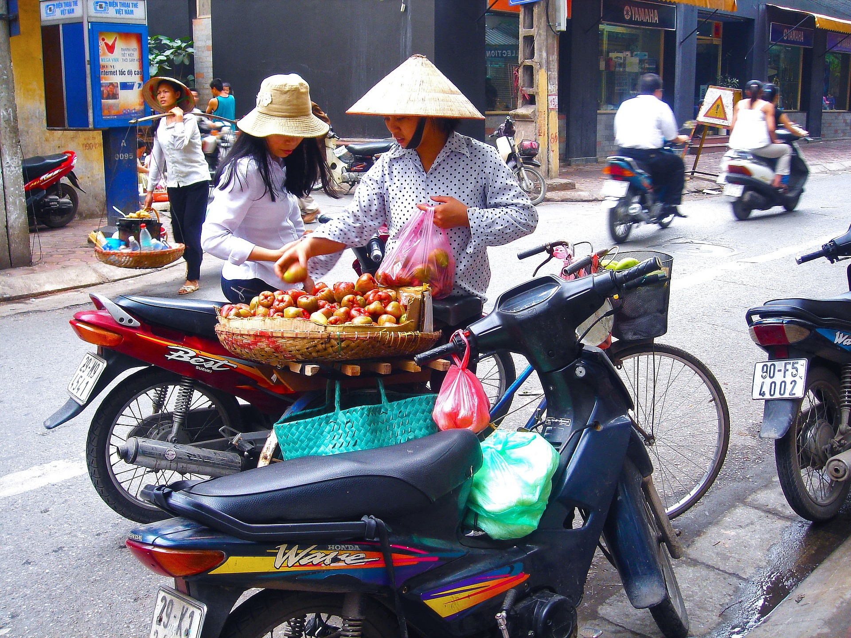
Notes:
Asia use differently

Slide 60
Page Conversion Rate
3 Seconds
Notes:
Page Conversion Rate

Slide 61
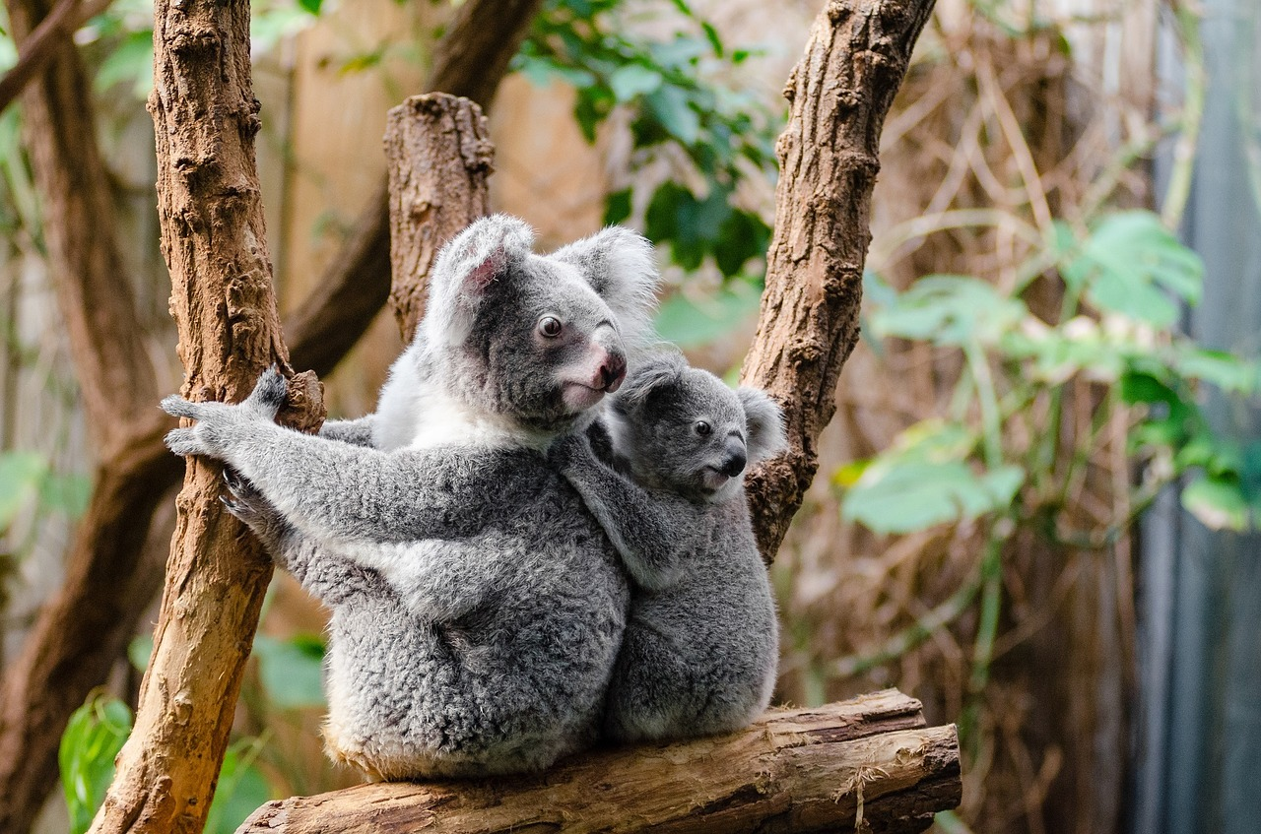
Notes:
Increase in revenue in Australia.

Slide 62
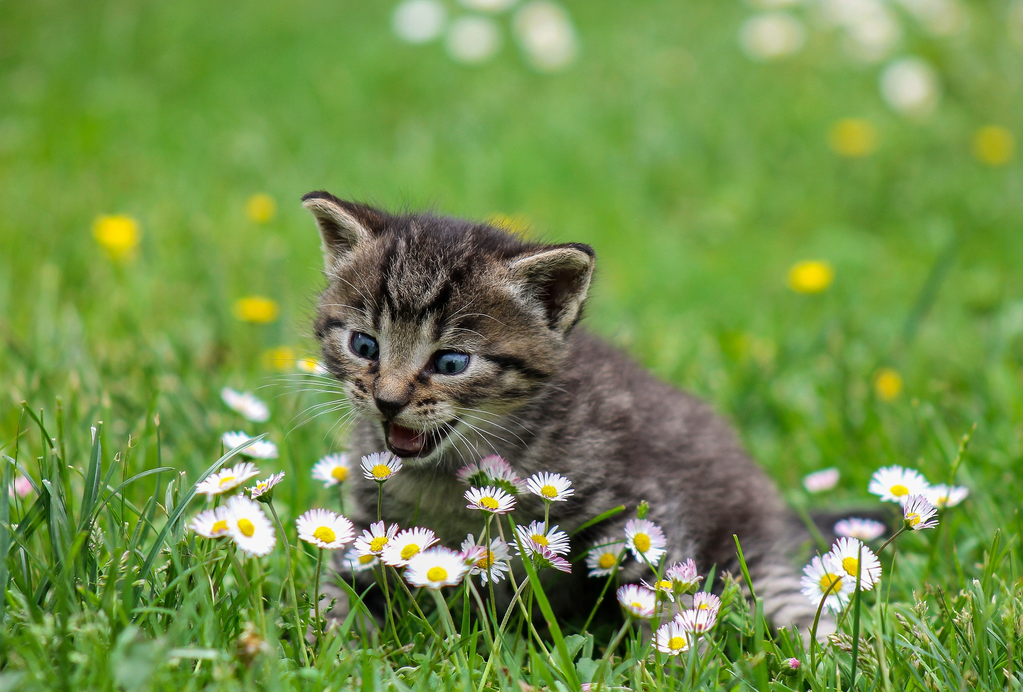
Notes:
Better scores if you include pictures of cats

Slide 63

Notes:
Panels & Usability testing

Slide 64

Notes:
Ethnography

Slide 65
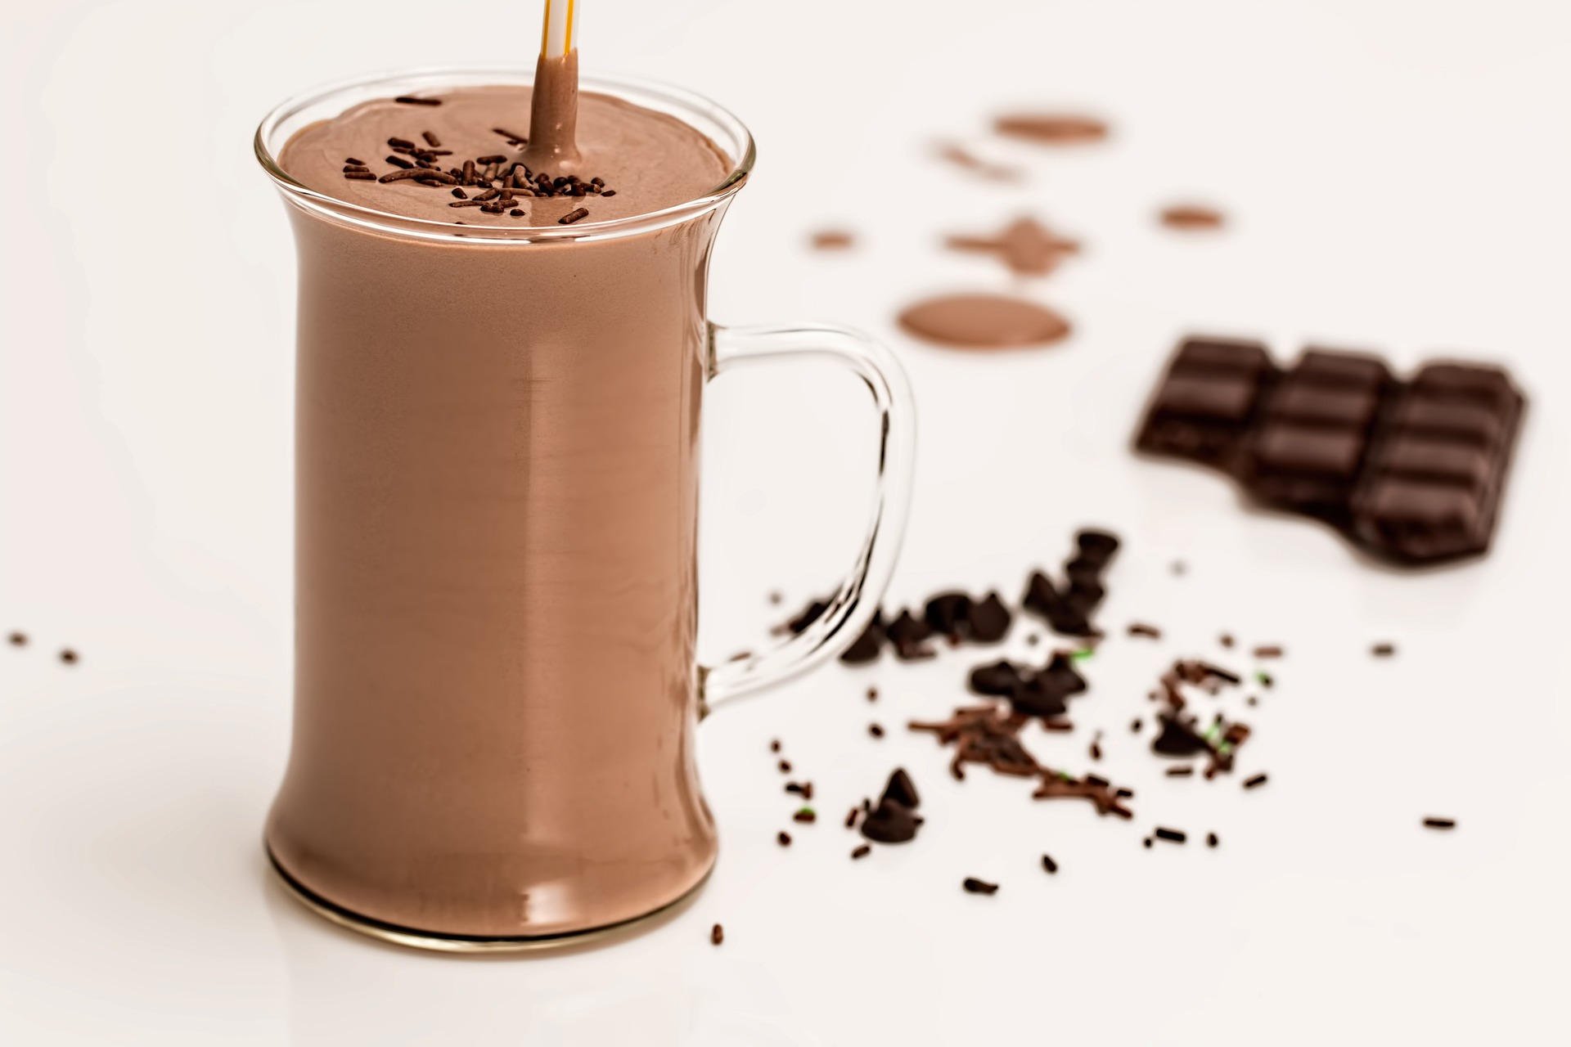
Notes:
User needs and jobs to be done.

Slide 66
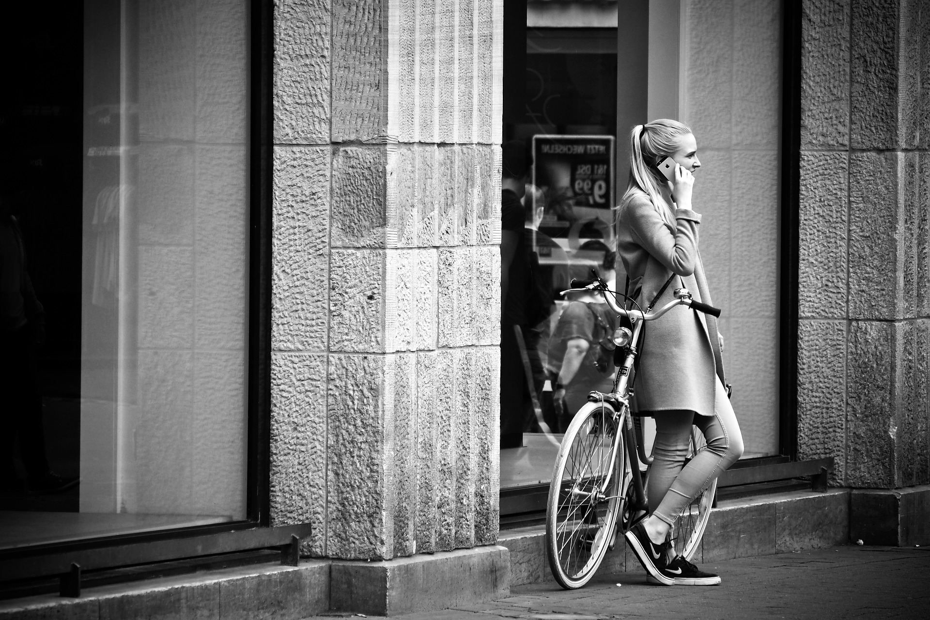
Notes:
Call Centre – PO meet call center every two weeks.

Slide 67
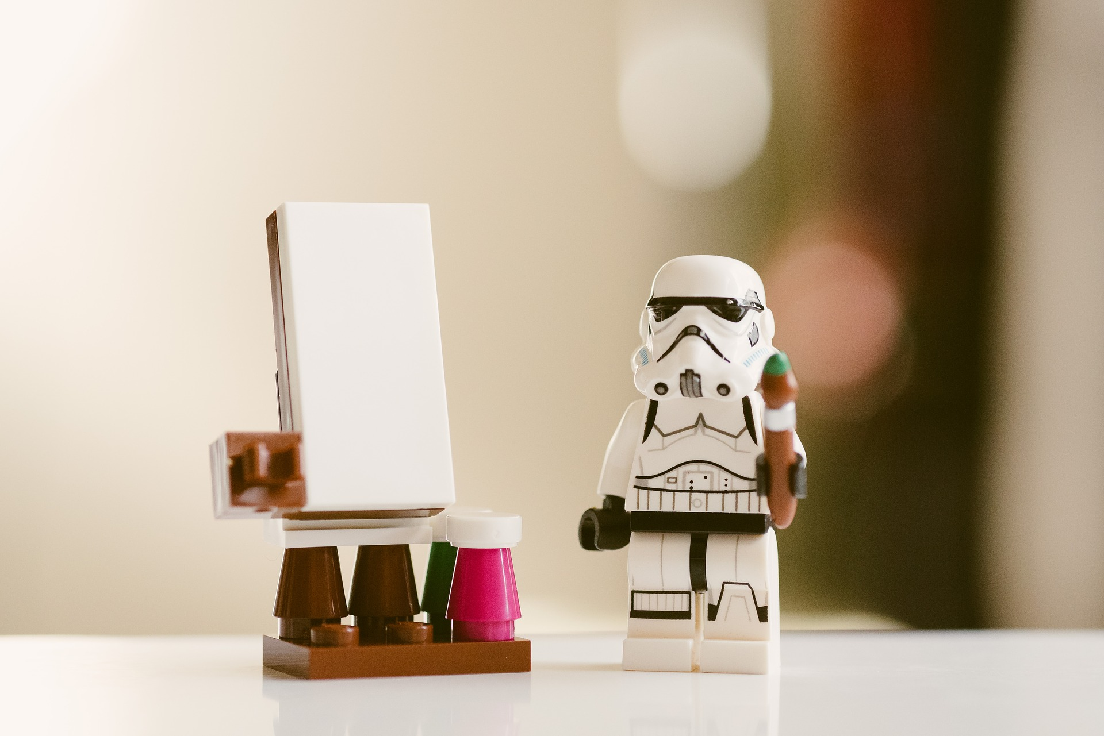
Notes:
System Thinkers & Model Office.

Slide 68
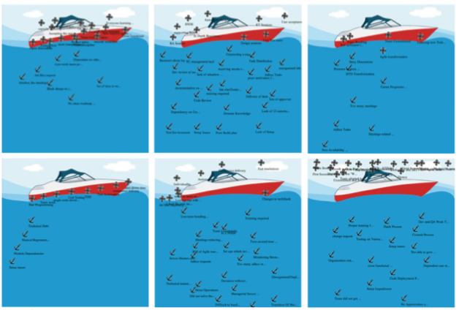
www.conteneo.com
Notes:
Contaneo – On-line feedback

Slide 69
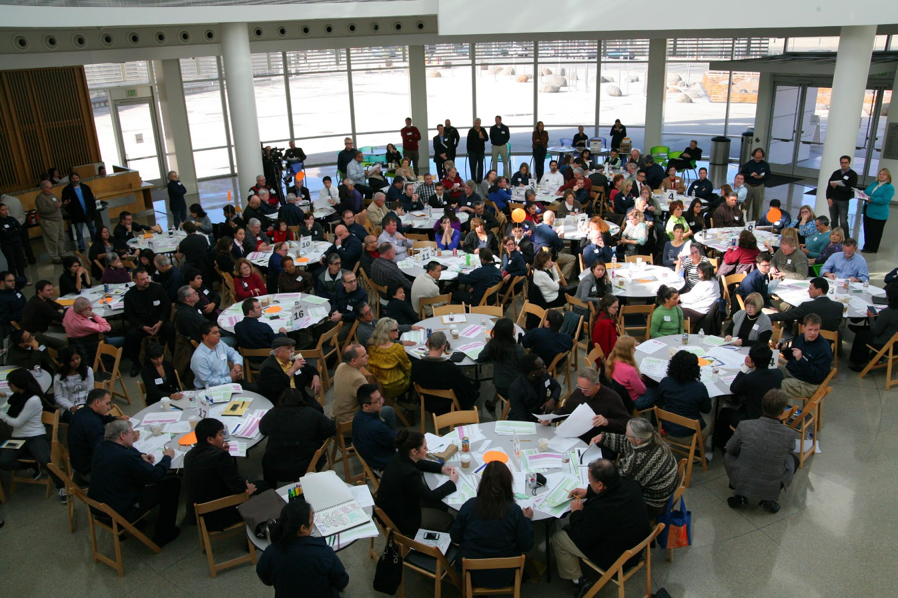
Notes:
San Jose – Budget Games

Slide 70
Imdb.com

Slide 71
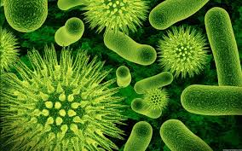
Notes:
Its about culture! I know versus Lets ask the user.

Slide 72
Process☒
Risk Manager☑

Slide 73


Slide 74
http://corporate.dominos.co.uk

Slide 75
http://corporate.dominos.co.uk

Slide 76
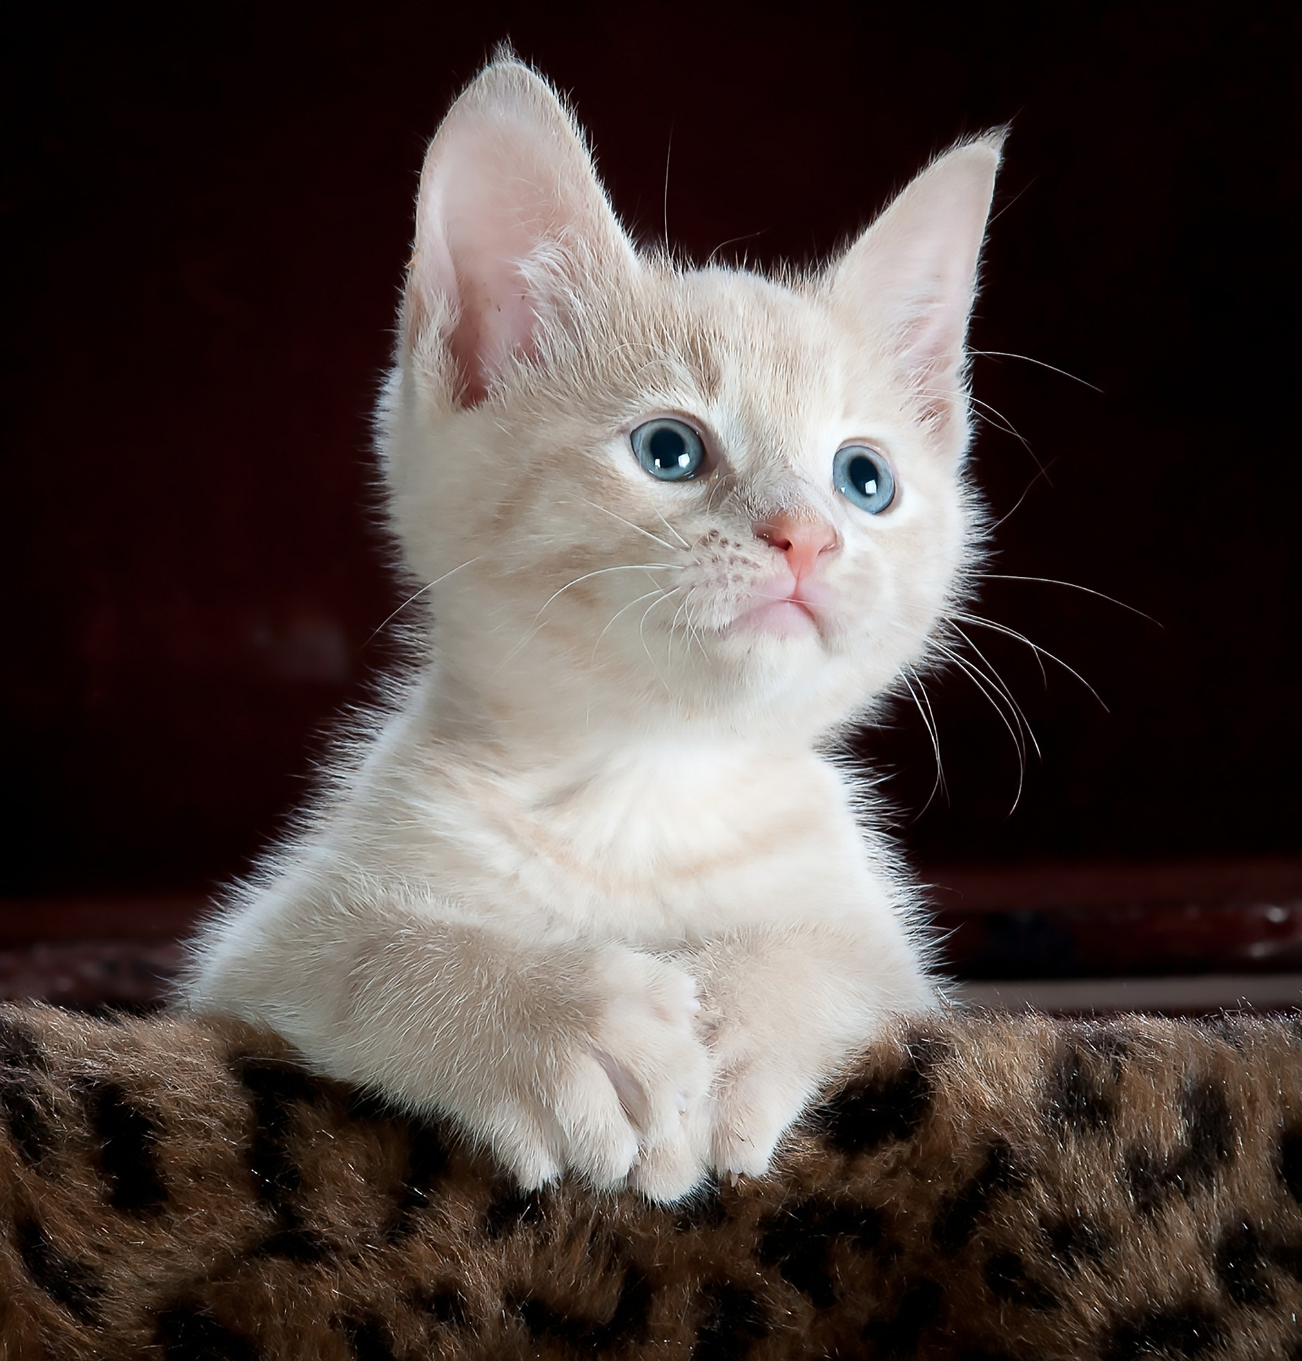
#ContentNotCats
@PapaChrisMatts

Slide 77
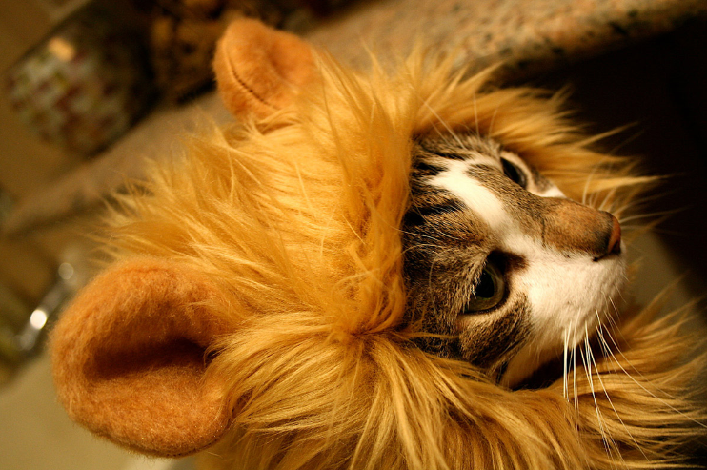

Slide 78

@PapaChrisMatts
theITRiskManager.wordpress.com

